Slide 1
Introduction to Pentaho

Slide 2
Day 1 Agenda
Introduction
Pentaho Environment
Design Transformation using PDI
Working with files
Transformations Steps

Slide 3


Slide 4
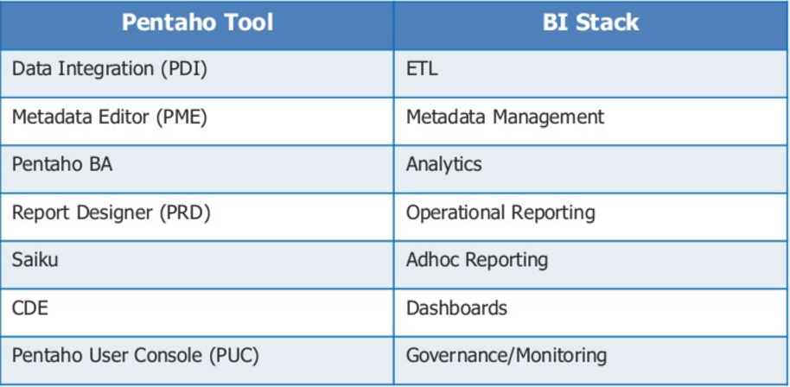
Pentaho Tools
Notes:
Pentaho Metadata Editor (PME) is a tool that allows you to build Pentaho metadata domains and relational data models. A Pentaho Metadata Model maps the physical structure of your database into a logical business model. These mappings are stored in a centralized metadata repository and allow administrators to:
Create business-language definitions for complex or cryptic database tables
Decrease the cost and impact associated with low level database changes
Set security parameters limiting user's report access to data
Drive formatting on text, date, and numeric data improving report maintenance
Localize the information to the user's regional settings

Slide 5
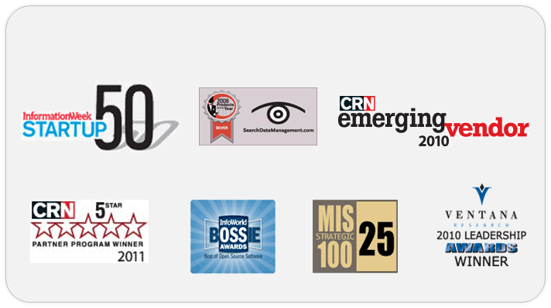
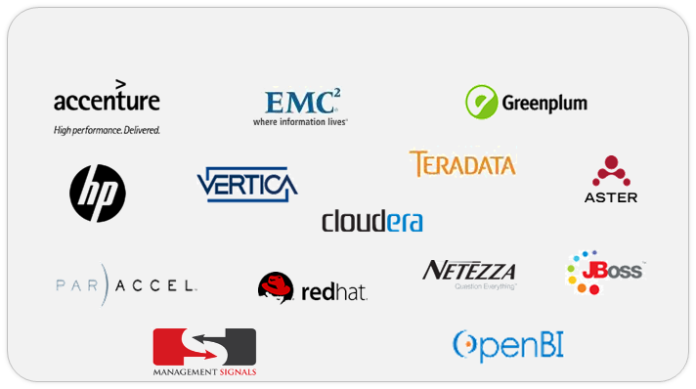
About Pentaho
Recognized leader in business analytics & data integration
Subscription-based business model
Achieved critical mass:
Over 1,200 commercial customers
Over 10,000 production deployments
Over 185 countries
Stewardship of most important open source analytics projects
Notes:
Traditionally, data was organized in file formats. DBMS was a new concept then, and all the research was done to make it overcome the deficiencies in traditional style of data management. A modern DBMS has the following characteristics −
Real-world entity − A modern DBMS is more realistic and uses real-world entities to design its architecture. It uses the behavior and attributes too. For example, a school database may use students as an entity and their age as an attribute.
Relation-based tables − DBMS allows entities and relations among them to form tables. A user can understand the architecture of a database just by looking at the table names.
Isolation of data and application − A database system is entirely different than its data. A database is an active entity, whereas data is said to be passive, on which the database works and organizes. DBMS also stores metadata, which is data about data, to ease its own process.
Less redundancy − DBMS follows the rules of normalization, which splits a relation when any of its attributes is having redundancy in values. Normalization is a mathematically rich and scientific process that reduces data redundancy.
Consistency − Consistency is a state where every relation in a database remains consistent. There exist methods and techniques, which can detect attempt of leaving database in inconsistent state. A DBMS can provide greater consistency as compared to earlier forms of data storing applications like file-processing systems.
Query Language − DBMS is equipped with query language, which makes it more efficient to retrieve and manipulate data. A user can apply as many and as different filtering options as required to retrieve a set of data. Traditionally it was not possible where file-processing system was used.
ACID Properties − DBMS follows the concepts of Atomicity, Consistency, Isolation, and Durability (normally shortened as ACID). These concepts are applied on transactions, which manipulate data in a database. ACID properties help the database stay healthy in multi-transactional environments and in case of failure.
Multiuser and Concurrent Access − DBMS supports multi-user environment and allows them to access and manipulate data in parallel. Though there are restrictions on transactions when users attempt to handle the same data item, but users are always unaware of them.
Multiple views − DBMS offers multiple views for different users. A user who is in the Sales department will have a different view of database than a person working in the Production department. This feature enables the users to have a concentrate view of the database according to their requirements.
Security − Features like multiple views offer security to some extent where users are unable to access data of other users and departments. DBMS offers methods to impose constraints while entering data into the database and retrieving the same at a later stage. DBMS offers many different levels of security features, which enables multiple users to have different views with different features. For example, a user in the Sales department cannot see the data that belongs to the Purchase department. Additionally, it can also be managed how much data of the Sales department should be displayed to the user. Since a DBMS is not saved on the disk as traditional file systems, it is very hard for miscreants to break the code.

Slide 6
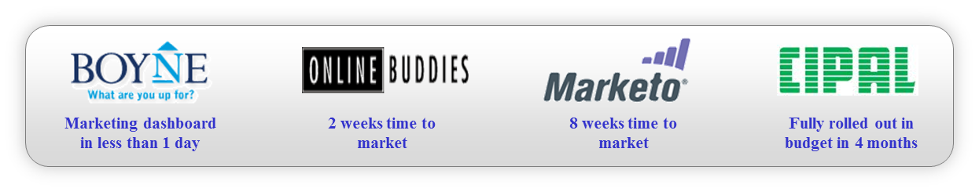
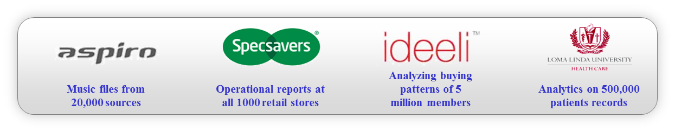

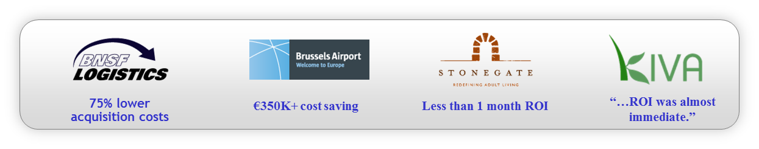
Why Pentaho
Speed of
Deployment
Innovation &
Scalability
Customer
Service
Total Value
Notes:
Traditionally, data was organized in file formats. DBMS was a new concept then, and all the research was done to make it overcome the deficiencies in traditional style of data management. A modern DBMS has the following characteristics −
Real-world entity − A modern DBMS is more realistic and uses real-world entities to design its architecture. It uses the behavior and attributes too. For example, a school database may use students as an entity and their age as an attribute.
Relation-based tables − DBMS allows entities and relations among them to form tables. A user can understand the architecture of a database just by looking at the table names.
Isolation of data and application − A database system is entirely different than its data. A database is an active entity, whereas data is said to be passive, on which the database works and organizes. DBMS also stores metadata, which is data about data, to ease its own process.
Less redundancy − DBMS follows the rules of normalization, which splits a relation when any of its attributes is having redundancy in values. Normalization is a mathematically rich and scientific process that reduces data redundancy.
Consistency − Consistency is a state where every relation in a database remains consistent. There exist methods and techniques, which can detect attempt of leaving database in inconsistent state. A DBMS can provide greater consistency as compared to earlier forms of data storing applications like file-processing systems.
Query Language − DBMS is equipped with query language, which makes it more efficient to retrieve and manipulate data. A user can apply as many and as different filtering options as required to retrieve a set of data. Traditionally it was not possible where file-processing system was used.
ACID Properties − DBMS follows the concepts of Atomicity, Consistency, Isolation, and Durability (normally shortened as ACID). These concepts are applied on transactions, which manipulate data in a database. ACID properties help the database stay healthy in multi-transactional environments and in case of failure.
Multiuser and Concurrent Access − DBMS supports multi-user environment and allows them to access and manipulate data in parallel. Though there are restrictions on transactions when users attempt to handle the same data item, but users are always unaware of them.
Multiple views − DBMS offers multiple views for different users. A user who is in the Sales department will have a different view of database than a person working in the Production department. This feature enables the users to have a concentrate view of the database according to their requirements.
Security − Features like multiple views offer security to some extent where users are unable to access data of other users and departments. DBMS offers methods to impose constraints while entering data into the database and retrieving the same at a later stage. DBMS offers many different levels of security features, which enables multiple users to have different views with different features. For example, a user in the Sales department cannot see the data that belongs to the Purchase department. Additionally, it can also be managed how much data of the Sales department should be displayed to the user. Since a DBMS is not saved on the disk as traditional file systems, it is very hard for miscreants to break the code.

Slide 7
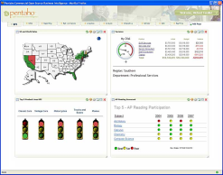

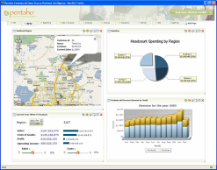

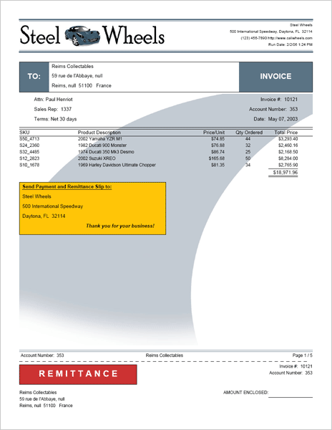
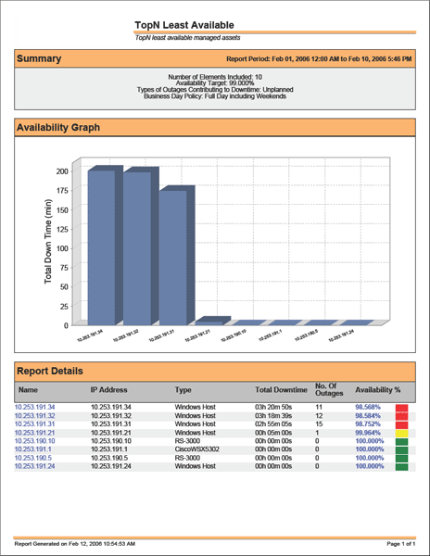

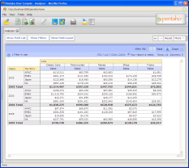
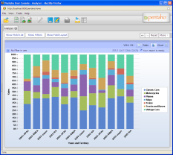

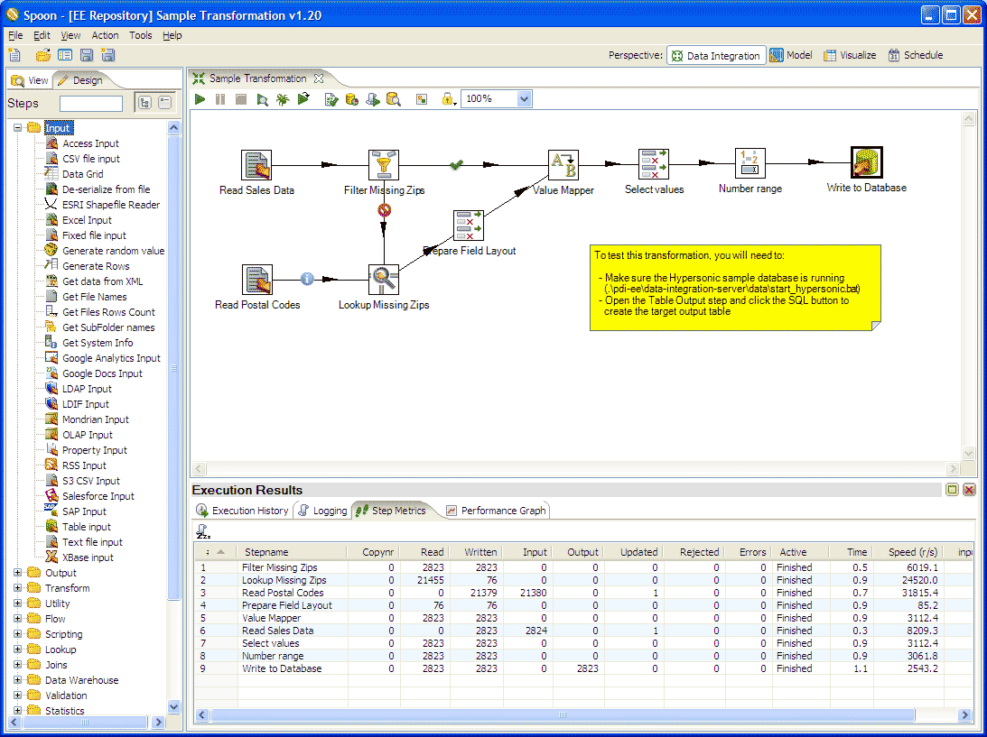
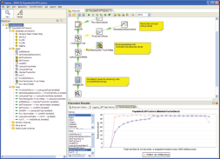

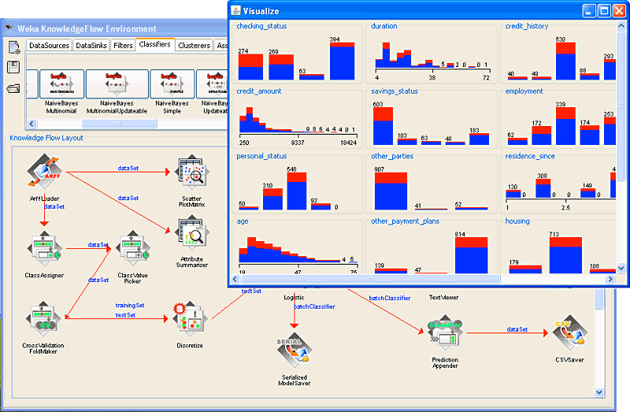
Why Pentaho
Components Are Independent
Dashboards
Self-service Interactive KPI & Metrics and Visualization
Information Consumers
Reporting
Ad hoc and Operational Reports
Business Users
Analysis
Self-service Interactive and Ad Hoc Analysis
Knowledge Workers/ Business Users
Data
High Performance Data Integration, BIG DATA,Cleansing and Presentation
Power Users,
Developers & DBAs
Data Mining
Advanced Predictive Analysis
Advanced Power Users
& Viewers
Notes:
Traditionally, data was organized in file formats. DBMS was a new concept then, and all the research was done to make it overcome the deficiencies in traditional style of data management. A modern DBMS has the following characteristics −
Real-world entity − A modern DBMS is more realistic and uses real-world entities to design its architecture. It uses the behavior and attributes too. For example, a school database may use students as an entity and their age as an attribute.
Relation-based tables − DBMS allows entities and relations among them to form tables. A user can understand the architecture of a database just by looking at the table names.
Isolation of data and application − A database system is entirely different than its data. A database is an active entity, whereas data is said to be passive, on which the database works and organizes. DBMS also stores metadata, which is data about data, to ease its own process.
Less redundancy − DBMS follows the rules of normalization, which splits a relation when any of its attributes is having redundancy in values. Normalization is a mathematically rich and scientific process that reduces data redundancy.
Consistency − Consistency is a state where every relation in a database remains consistent. There exist methods and techniques, which can detect attempt of leaving database in inconsistent state. A DBMS can provide greater consistency as compared to earlier forms of data storing applications like file-processing systems.
Query Language − DBMS is equipped with query language, which makes it more efficient to retrieve and manipulate data. A user can apply as many and as different filtering options as required to retrieve a set of data. Traditionally it was not possible where file-processing system was used.
ACID Properties − DBMS follows the concepts of Atomicity, Consistency, Isolation, and Durability (normally shortened as ACID). These concepts are applied on transactions, which manipulate data in a database. ACID properties help the database stay healthy in multi-transactional environments and in case of failure.
Multiuser and Concurrent Access − DBMS supports multi-user environment and allows them to access and manipulate data in parallel. Though there are restrictions on transactions when users attempt to handle the same data item, but users are always unaware of them.
Multiple views − DBMS offers multiple views for different users. A user who is in the Sales department will have a different view of database than a person working in the Production department. This feature enables the users to have a concentrate view of the database according to their requirements.
Security − Features like multiple views offer security to some extent where users are unable to access data of other users and departments. DBMS offers methods to impose constraints while entering data into the database and retrieving the same at a later stage. DBMS offers many different levels of security features, which enables multiple users to have different views with different features. For example, a user in the Sales department cannot see the data that belongs to the Purchase department. Additionally, it can also be managed how much data of the Sales department should be displayed to the user. Since a DBMS is not saved on the disk as traditional file systems, it is very hard for miscreants to break the code.

Slide 8
Why Pentaho
One stop solution for all business analytics need
Low integration time and infrastructure cost
Huge community support
Easily Scalable
Virtually unlimited visualization and data sources
Easily integrated on top of existing infrastructure including any big data ecosystem
All core engines are open and standalone projects with their own community and development plan
A very good toolset which has far wider applicability beyond just the base project
Notes:
Traditionally, data was organized in file formats. DBMS was a new concept then, and all the research was done to make it overcome the deficiencies in traditional style of data management. A modern DBMS has the following characteristics −
Real-world entity − A modern DBMS is more realistic and uses real-world entities to design its architecture. It uses the behavior and attributes too. For example, a school database may use students as an entity and their age as an attribute.
Relation-based tables − DBMS allows entities and relations among them to form tables. A user can understand the architecture of a database just by looking at the table names.
Isolation of data and application − A database system is entirely different than its data. A database is an active entity, whereas data is said to be passive, on which the database works and organizes. DBMS also stores metadata, which is data about data, to ease its own process.
Less redundancy − DBMS follows the rules of normalization, which splits a relation when any of its attributes is having redundancy in values. Normalization is a mathematically rich and scientific process that reduces data redundancy.
Consistency − Consistency is a state where every relation in a database remains consistent. There exist methods and techniques, which can detect attempt of leaving database in inconsistent state. A DBMS can provide greater consistency as compared to earlier forms of data storing applications like file-processing systems.
Query Language − DBMS is equipped with query language, which makes it more efficient to retrieve and manipulate data. A user can apply as many and as different filtering options as required to retrieve a set of data. Traditionally it was not possible where file-processing system was used.
ACID Properties − DBMS follows the concepts of Atomicity, Consistency, Isolation, and Durability (normally shortened as ACID). These concepts are applied on transactions, which manipulate data in a database. ACID properties help the database stay healthy in multi-transactional environments and in case of failure.
Multiuser and Concurrent Access − DBMS supports multi-user environment and allows them to access and manipulate data in parallel. Though there are restrictions on transactions when users attempt to handle the same data item, but users are always unaware of them.
Multiple views − DBMS offers multiple views for different users. A user who is in the Sales department will have a different view of database than a person working in the Production department. This feature enables the users to have a concentrate view of the database according to their requirements.
Security − Features like multiple views offer security to some extent where users are unable to access data of other users and departments. DBMS offers methods to impose constraints while entering data into the database and retrieving the same at a later stage. DBMS offers many different levels of security features, which enables multiple users to have different views with different features. For example, a user in the Sales department cannot see the data that belongs to the Purchase department. Additionally, it can also be managed how much data of the Sales department should be displayed to the user. Since a DBMS is not saved on the disk as traditional file systems, it is very hard for miscreants to break the code.

Slide 9
Features - EASE OF USE WITH THE POWER TO INTEGRATE ALL DATA
Intuitive drag-and-drop data integration coupled with data agnostic connectivity spanning from flat files and RDBMS to Hadoop and beyond.
Graphical extract-transform-load (ETL) designer to simplify the creation of data pipelines
Rich library of pre-built components to access, prepare, and blend data from relational sources, big data stores, enterprise applications, and more
Powerful orchestration capabilities to coordinate and combine transformations, including notifications and alerts
Agile views for modeling and visualizing data on the fly during the data preparation process
Integrated enterprise scheduler for coordinating workflows and debugger for testing and tuning job execution
Notes:
Traditionally, data was organized in file formats. DBMS was a new concept then, and all the research was done to make it overcome the deficiencies in traditional style of data management. A modern DBMS has the following characteristics −
Real-world entity − A modern DBMS is more realistic and uses real-world entities to design its architecture. It uses the behavior and attributes too. For example, a school database may use students as an entity and their age as an attribute.
Relation-based tables − DBMS allows entities and relations among them to form tables. A user can understand the architecture of a database just by looking at the table names.
Isolation of data and application − A database system is entirely different than its data. A database is an active entity, whereas data is said to be passive, on which the database works and organizes. DBMS also stores metadata, which is data about data, to ease its own process.
Less redundancy − DBMS follows the rules of normalization, which splits a relation when any of its attributes is having redundancy in values. Normalization is a mathematically rich and scientific process that reduces data redundancy.
Consistency − Consistency is a state where every relation in a database remains consistent. There exist methods and techniques, which can detect attempt of leaving database in inconsistent state. A DBMS can provide greater consistency as compared to earlier forms of data storing applications like file-processing systems.
Query Language − DBMS is equipped with query language, which makes it more efficient to retrieve and manipulate data. A user can apply as many and as different filtering options as required to retrieve a set of data. Traditionally it was not possible where file-processing system was used.
ACID Properties − DBMS follows the concepts of Atomicity, Consistency, Isolation, and Durability (normally shortened as ACID). These concepts are applied on transactions, which manipulate data in a database. ACID properties help the database stay healthy in multi-transactional environments and in case of failure.
Multiuser and Concurrent Access − DBMS supports multi-user environment and allows them to access and manipulate data in parallel. Though there are restrictions on transactions when users attempt to handle the same data item, but users are always unaware of them.
Multiple views − DBMS offers multiple views for different users. A user who is in the Sales department will have a different view of database than a person working in the Production department. This feature enables the users to have a concentrate view of the database according to their requirements.
Security − Features like multiple views offer security to some extent where users are unable to access data of other users and departments. DBMS offers methods to impose constraints while entering data into the database and retrieving the same at a later stage. DBMS offers many different levels of security features, which enables multiple users to have different views with different features. For example, a user in the Sales department cannot see the data that belongs to the Purchase department. Additionally, it can also be managed how much data of the Sales department should be displayed to the user. Since a DBMS is not saved on the disk as traditional file systems, it is very hard for miscreants to break the code.

Slide 10
Features - BIG DATA INTEGRATION WITH ZERO CODING REQUIRED
Pentaho's intuitive toolset accelerates the design and deployment of big data analytics by up to 15 times compared to hand-coding techniques.
Complete visual big data integration tools eliminate manual programming and scripting from the process
Deep integration and the Adaptive Big Data Layer accelerate access to the latest versions and capabilities of popular big data stores
Robust support for Hadoop distributions, Spark, NoSQL data stores and analytic databases
Empowers users to architect big data blends at the source, and stream them directly for more complete and accurate analytics
Integrate advanced analytic models from R, Python, and Weka to operationalize predictive models, while reducing data prep time
Notes:
Traditionally, data was organized in file formats. DBMS was a new concept then, and all the research was done to make it overcome the deficiencies in traditional style of data management. A modern DBMS has the following characteristics −
Real-world entity − A modern DBMS is more realistic and uses real-world entities to design its architecture. It uses the behavior and attributes too. For example, a school database may use students as an entity and their age as an attribute.
Relation-based tables − DBMS allows entities and relations among them to form tables. A user can understand the architecture of a database just by looking at the table names.
Isolation of data and application − A database system is entirely different than its data. A database is an active entity, whereas data is said to be passive, on which the database works and organizes. DBMS also stores metadata, which is data about data, to ease its own process.
Less redundancy − DBMS follows the rules of normalization, which splits a relation when any of its attributes is having redundancy in values. Normalization is a mathematically rich and scientific process that reduces data redundancy.
Consistency − Consistency is a state where every relation in a database remains consistent. There exist methods and techniques, which can detect attempt of leaving database in inconsistent state. A DBMS can provide greater consistency as compared to earlier forms of data storing applications like file-processing systems.
Query Language − DBMS is equipped with query language, which makes it more efficient to retrieve and manipulate data. A user can apply as many and as different filtering options as required to retrieve a set of data. Traditionally it was not possible where file-processing system was used.
ACID Properties − DBMS follows the concepts of Atomicity, Consistency, Isolation, and Durability (normally shortened as ACID). These concepts are applied on transactions, which manipulate data in a database. ACID properties help the database stay healthy in multi-transactional environments and in case of failure.
Multiuser and Concurrent Access − DBMS supports multi-user environment and allows them to access and manipulate data in parallel. Though there are restrictions on transactions when users attempt to handle the same data item, but users are always unaware of them.
Multiple views − DBMS offers multiple views for different users. A user who is in the Sales department will have a different view of database than a person working in the Production department. This feature enables the users to have a concentrate view of the database according to their requirements.
Security − Features like multiple views offer security to some extent where users are unable to access data of other users and departments. DBMS offers methods to impose constraints while entering data into the database and retrieving the same at a later stage. DBMS offers many different levels of security features, which enables multiple users to have different views with different features. For example, a user in the Sales department cannot see the data that belongs to the Purchase department. Additionally, it can also be managed how much data of the Sales department should be displayed to the user. Since a DBMS is not saved on the disk as traditional file systems, it is very hard for miscreants to break the code.

Slide 11
Features - BRINGING ANALYTICS INTO DATA PREP
Pentaho is the only vendor on the market to deliver a visual data experience from anywhere in the data pipeline, with a single platform.
Access any analytics, including charts, visualizations, and reporting, from any step in data prep– shortening the cycle from data to analytics
ETL developers and data prep staff can easily spot check analytics in-flight
Directly publish data sources for the business user, creating a more collaborative process between business and IT
Data services to virtualize transformations without staging, making data sets immediately available to reports and applications
Set up a self-service data prep environment with governed, on-demand data sets
Notes:
Traditionally, data was organized in file formats. DBMS was a new concept then, and all the research was done to make it overcome the deficiencies in traditional style of data management. A modern DBMS has the following characteristics −
Real-world entity − A modern DBMS is more realistic and uses real-world entities to design its architecture. It uses the behavior and attributes too. For example, a school database may use students as an entity and their age as an attribute.
Relation-based tables − DBMS allows entities and relations among them to form tables. A user can understand the architecture of a database just by looking at the table names.
Isolation of data and application − A database system is entirely different than its data. A database is an active entity, whereas data is said to be passive, on which the database works and organizes. DBMS also stores metadata, which is data about data, to ease its own process.
Less redundancy − DBMS follows the rules of normalization, which splits a relation when any of its attributes is having redundancy in values. Normalization is a mathematically rich and scientific process that reduces data redundancy.
Consistency − Consistency is a state where every relation in a database remains consistent. There exist methods and techniques, which can detect attempt of leaving database in inconsistent state. A DBMS can provide greater consistency as compared to earlier forms of data storing applications like file-processing systems.
Query Language − DBMS is equipped with query language, which makes it more efficient to retrieve and manipulate data. A user can apply as many and as different filtering options as required to retrieve a set of data. Traditionally it was not possible where file-processing system was used.
ACID Properties − DBMS follows the concepts of Atomicity, Consistency, Isolation, and Durability (normally shortened as ACID). These concepts are applied on transactions, which manipulate data in a database. ACID properties help the database stay healthy in multi-transactional environments and in case of failure.
Multiuser and Concurrent Access − DBMS supports multi-user environment and allows them to access and manipulate data in parallel. Though there are restrictions on transactions when users attempt to handle the same data item, but users are always unaware of them.
Multiple views − DBMS offers multiple views for different users. A user who is in the Sales department will have a different view of database than a person working in the Production department. This feature enables the users to have a concentrate view of the database according to their requirements.
Security − Features like multiple views offer security to some extent where users are unable to access data of other users and departments. DBMS offers methods to impose constraints while entering data into the database and retrieving the same at a later stage. DBMS offers many different levels of security features, which enables multiple users to have different views with different features. For example, a user in the Sales department cannot see the data that belongs to the Purchase department. Additionally, it can also be managed how much data of the Sales department should be displayed to the user. Since a DBMS is not saved on the disk as traditional file systems, it is very hard for miscreants to break the code.

Slide 12
Features - ENTERPRISE PLATFORM TO ACCELERATE THE DATA PIPELINE
Go beyond standard ETL to scalable and flexible management for end-to-end data flows.
Dynamic and reusable data integration templates that drive massive time savings through dynamically creating transformations on the fly
Multi-threaded data integration engine architected to scale up and out, including deployment to clustered and cloud environments
Robust administration features including performance monitoring, job roll-back and restart, and an operations mart for usage auditing
Enterprise-grade security including access and version controls as well as LDAP and Active Directory integration
Data quality and enrichment plug-ins from partner Melissa Data promote enhanced data management
Flexibility to merge data integration with business intelligence service to simplify configuration, deployment and administration
Notes:
Traditionally, data was organized in file formats. DBMS was a new concept then, and all the research was done to make it overcome the deficiencies in traditional style of data management. A modern DBMS has the following characteristics −
Real-world entity − A modern DBMS is more realistic and uses real-world entities to design its architecture. It uses the behavior and attributes too. For example, a school database may use students as an entity and their age as an attribute.
Relation-based tables − DBMS allows entities and relations among them to form tables. A user can understand the architecture of a database just by looking at the table names.
Isolation of data and application − A database system is entirely different than its data. A database is an active entity, whereas data is said to be passive, on which the database works and organizes. DBMS also stores metadata, which is data about data, to ease its own process.
Less redundancy − DBMS follows the rules of normalization, which splits a relation when any of its attributes is having redundancy in values. Normalization is a mathematically rich and scientific process that reduces data redundancy.
Consistency − Consistency is a state where every relation in a database remains consistent. There exist methods and techniques, which can detect attempt of leaving database in inconsistent state. A DBMS can provide greater consistency as compared to earlier forms of data storing applications like file-processing systems.
Query Language − DBMS is equipped with query language, which makes it more efficient to retrieve and manipulate data. A user can apply as many and as different filtering options as required to retrieve a set of data. Traditionally it was not possible where file-processing system was used.
ACID Properties − DBMS follows the concepts of Atomicity, Consistency, Isolation, and Durability (normally shortened as ACID). These concepts are applied on transactions, which manipulate data in a database. ACID properties help the database stay healthy in multi-transactional environments and in case of failure.
Multiuser and Concurrent Access − DBMS supports multi-user environment and allows them to access and manipulate data in parallel. Though there are restrictions on transactions when users attempt to handle the same data item, but users are always unaware of them.
Multiple views − DBMS offers multiple views for different users. A user who is in the Sales department will have a different view of database than a person working in the Production department. This feature enables the users to have a concentrate view of the database according to their requirements.
Security − Features like multiple views offer security to some extent where users are unable to access data of other users and departments. DBMS offers methods to impose constraints while entering data into the database and retrieving the same at a later stage. DBMS offers many different levels of security features, which enables multiple users to have different views with different features. For example, a user in the Sales department cannot see the data that belongs to the Purchase department. Additionally, it can also be managed how much data of the Sales department should be displayed to the user. Since a DBMS is not saved on the disk as traditional file systems, it is very hard for miscreants to break the code.

Slide 13
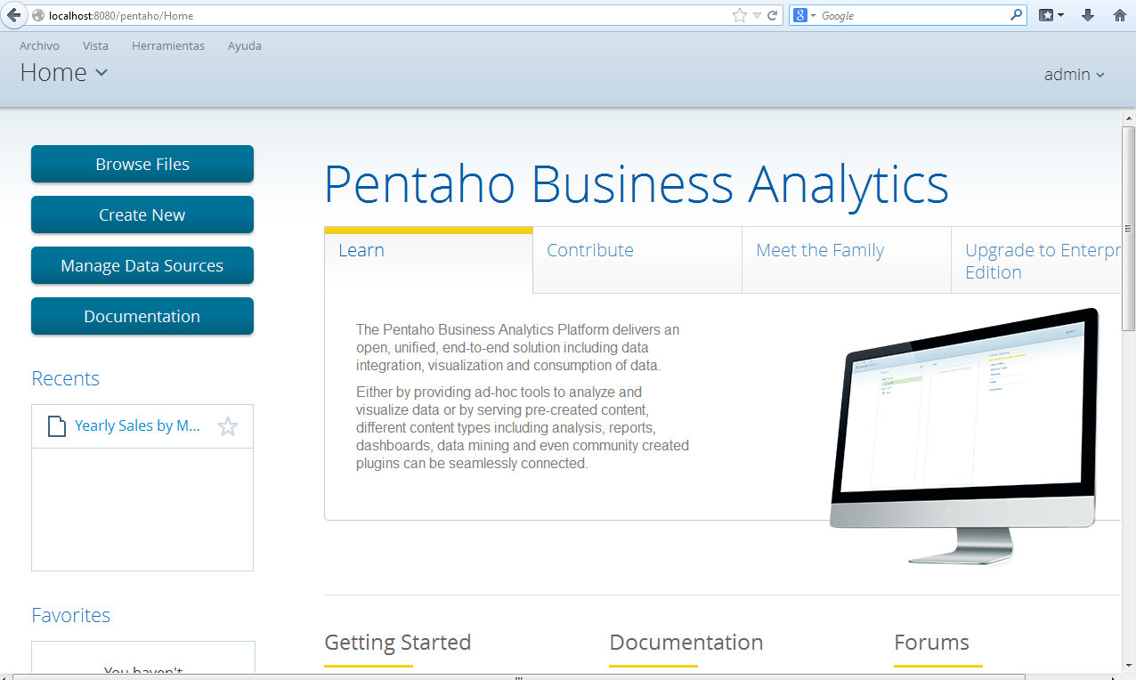
Pentaho BA Server (Server Layer)

Slide 14
Pentaho BA Server (Server Layer)
This platform was recently renamed to BI to BA, makes up a core software piece on server side with following feature
Hosts content created in the server itself through plug-ins or file is published to the server from the desktop applications
Manages Security
Running reports
Displaying / Designing dashboard
Report bursting
OLAP analysis
Mondrian with MDX support
Pentaho Report Designer
Pentaho Analyzer

Slide 15
Pentaho BA Server (Server Layer)
Scheduling and Monitoring
Can be extended with commercial as well as open source (Ctools) plug-ins
Runs by default on Apache Tomcat but can be embedded in any Java based application server
Available in two flavors : Community Edition (CE) and Enterprise Edition (EE)

Slide 16
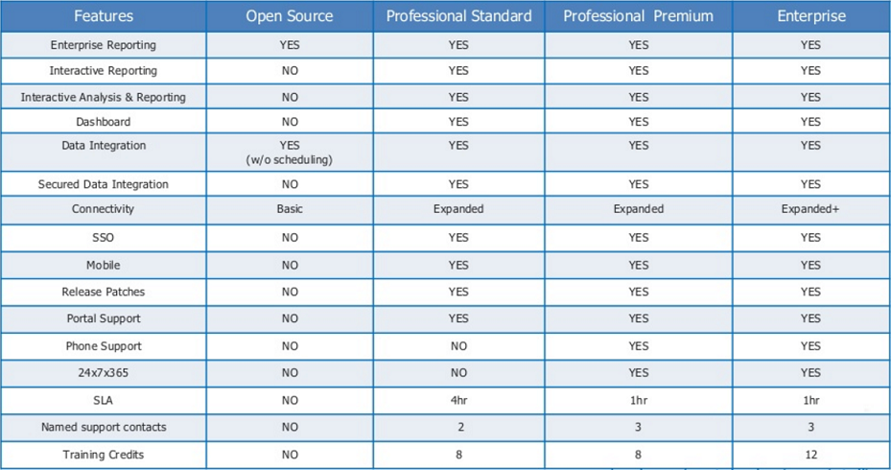
Pentaho BA Server : EE vs. CE

Slide 17
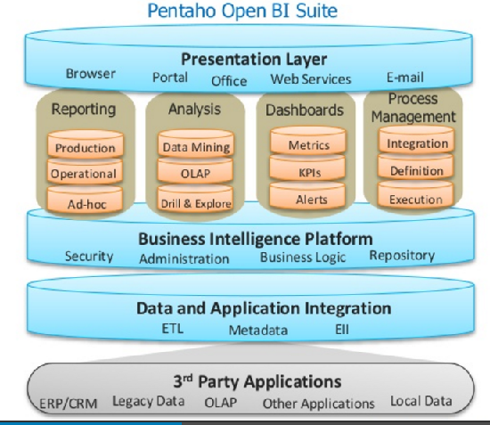
Pentaho Stack: Abstract Component View

Slide 18
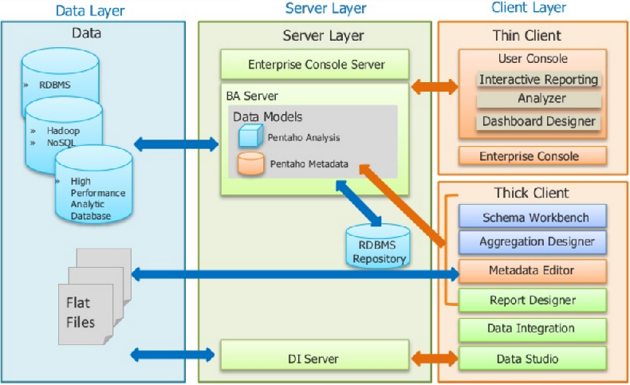
Pentaho Stack: Architecture View

Slide 19
Pentaho Data Integration
This is referred as PDI or still popularly known as Kettle which is original project name. This consist of
DI Server (Server application)
Core component
Executes job and transformations using pdi engine
Has default user and role based security. It can also be integrated with existing LDAP/Active Directory security provider
Design Tools
Spoon
Kitchen
Pan
Carte
Notes:
Each component is discussed individually below:
Data Source Layer
This represents the different data sources that feed data into the data warehouse. The data source can be of any format -- plain text file, relational database, other types of database, Excel file, etc., can all act as a data source.
Many different types of data can be a data source:
Operations -- such as sales data, HR data, product data, inventory data, marketing data, systems data.
Web server logs with user browsing data.
Internal market research data.
Third-party data, such as census data, demographics data, or survey data.
All these data sources together form the Data Source Layer.
Data Extraction Layer
Data gets pulled from the data source into the data warehouse system. There is likely some minimal data cleansing, but there is unlikely any major data transformation.
Staging Area
This is where data sits prior to being scrubbed and transformed into a data warehouse / data mart. Having one common area makes it easier for subsequent data processing / integration.
ETL Layer
This is where data gains its "intelligence", as logic is applied to transform the data from a transactional nature to an analytical nature. This layer is also where data cleansing happens. The ETL design phase is often the most time-consuming phase in a data warehousing project, and an ETL tool is often used in this layer.
Data Storage Layer
This is where the transformed and cleansed data sit. Based on scope and functionality, 3 types of entities can be found here: data warehouse, data mart, and operational data store (ODS). In any given system, you may have just one of the three, two of the three, or all three types.
Data Logic Layer
This is where business rules are stored. Business rules stored here do not affect the underlying data transformation rules, but do affect what the report looks like.
Data Presentation Layer
This refers to the information that reaches the users. This can be in a form of a tabular / graphical report in a browser, an emailed report that gets automatically generated and sent everyday, or an alert that warns users of exceptions, among others. Usually an OLAP tool and/or a reporting tool is used in this layer.
Metadata Layer
This is where information about the data stored in the data warehouse system is stored. A logical data model would be an example of something that's in the metadata layer. A metadata tool is often used to manage metadata.
System Operations Layer
This layer includes information on how the data warehouse system operates, such as ETL job status, system performance, and user access history.

Slide 20
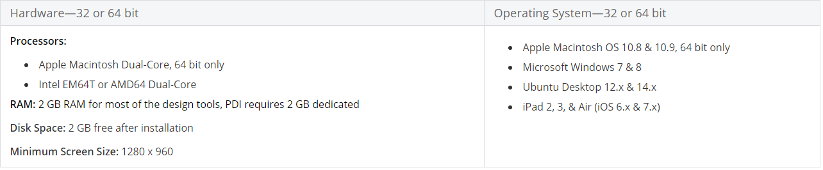
PDI Installation
Pentaho design tools are hardware-independent and run on client-class computers that comply with these specifications for minimum hardware and required operation systems
Reference - https://help.pentaho.com/Documentation/5.2/0D0/160/000
Notes:
Each component is discussed individually below:
Data Source Layer
This represents the different data sources that feed data into the data warehouse. The data source can be of any format -- plain text file, relational database, other types of database, Excel file, etc., can all act as a data source.
Many different types of data can be a data source:
Operations -- such as sales data, HR data, product data, inventory data, marketing data, systems data.
Web server logs with user browsing data.
Internal market research data.
Third-party data, such as census data, demographics data, or survey data.
All these data sources together form the Data Source Layer.
Data Extraction Layer
Data gets pulled from the data source into the data warehouse system. There is likely some minimal data cleansing, but there is unlikely any major data transformation.
Staging Area
This is where data sits prior to being scrubbed and transformed into a data warehouse / data mart. Having one common area makes it easier for subsequent data processing / integration.
ETL Layer
This is where data gains its "intelligence", as logic is applied to transform the data from a transactional nature to an analytical nature. This layer is also where data cleansing happens. The ETL design phase is often the most time-consuming phase in a data warehousing project, and an ETL tool is often used in this layer.
Data Storage Layer
This is where the transformed and cleansed data sit. Based on scope and functionality, 3 types of entities can be found here: data warehouse, data mart, and operational data store (ODS). In any given system, you may have just one of the three, two of the three, or all three types.
Data Logic Layer
This is where business rules are stored. Business rules stored here do not affect the underlying data transformation rules, but do affect what the report looks like.
Data Presentation Layer
This refers to the information that reaches the users. This can be in a form of a tabular / graphical report in a browser, an emailed report that gets automatically generated and sent everyday, or an alert that warns users of exceptions, among others. Usually an OLAP tool and/or a reporting tool is used in this layer.
Metadata Layer
This is where information about the data stored in the data warehouse system is stored. A logical data model would be an example of something that's in the metadata layer. A metadata tool is often used to manage metadata.
System Operations Layer
This layer includes information on how the data warehouse system operates, such as ETL job status, system performance, and user access history.

Slide 21
PDI Installation
Pentaho design tools are hardware-independent and run on client-class computers that comply with these specifications for minimum hardware and required operation systems
Reference - https://help.pentaho.com/Documentation/5.2/0D0/160/000
Notes:
Each component is discussed individually below:
Data Source Layer
This represents the different data sources that feed data into the data warehouse. The data source can be of any format -- plain text file, relational database, other types of database, Excel file, etc., can all act as a data source.
Many different types of data can be a data source:
Operations -- such as sales data, HR data, product data, inventory data, marketing data, systems data.
Web server logs with user browsing data.
Internal market research data.
Third-party data, such as census data, demographics data, or survey data.
All these data sources together form the Data Source Layer.
Data Extraction Layer
Data gets pulled from the data source into the data warehouse system. There is likely some minimal data cleansing, but there is unlikely any major data transformation.
Staging Area
This is where data sits prior to being scrubbed and transformed into a data warehouse / data mart. Having one common area makes it easier for subsequent data processing / integration.
ETL Layer
This is where data gains its "intelligence", as logic is applied to transform the data from a transactional nature to an analytical nature. This layer is also where data cleansing happens. The ETL design phase is often the most time-consuming phase in a data warehousing project, and an ETL tool is often used in this layer.
Data Storage Layer
This is where the transformed and cleansed data sit. Based on scope and functionality, 3 types of entities can be found here: data warehouse, data mart, and operational data store (ODS). In any given system, you may have just one of the three, two of the three, or all three types.
Data Logic Layer
This is where business rules are stored. Business rules stored here do not affect the underlying data transformation rules, but do affect what the report looks like.
Data Presentation Layer
This refers to the information that reaches the users. This can be in a form of a tabular / graphical report in a browser, an emailed report that gets automatically generated and sent everyday, or an alert that warns users of exceptions, among others. Usually an OLAP tool and/or a reporting tool is used in this layer.
Metadata Layer
This is where information about the data stored in the data warehouse system is stored. A logical data model would be an example of something that's in the metadata layer. A metadata tool is often used to manage metadata.
System Operations Layer
This layer includes information on how the data warehouse system operates, such as ETL job status, system performance, and user access history.

Slide 22
PDI Manual Installation (Linux)
Installing Java 8
To install Oracle Java 8 into your environment you can open a terminal and execute the commands below ( on Linux environment )
sudo add-apt-repository ppa:webupd8team/java
sudo apt-get update
sudo apt-get install oracle-java8-installer
sudo apt-get install oracle-java8-set-default
Before moving to the PDI 7 installation, confirm JAVA_HOME variable is corretly available into the environment. Using a terminal, please execute the command below
env | grep JAVA_HOME
If you get an empty result, execute nano ~/.bashrc and then append the command below to file content
export JAVA_HOME=/usr/lib/jvm/java-8-oracle
Notes:
Each component is discussed individually below:
Data Source Layer
This represents the different data sources that feed data into the data warehouse. The data source can be of any format -- plain text file, relational database, other types of database, Excel file, etc., can all act as a data source.
Many different types of data can be a data source:
Operations -- such as sales data, HR data, product data, inventory data, marketing data, systems data.
Web server logs with user browsing data.
Internal market research data.
Third-party data, such as census data, demographics data, or survey data.
All these data sources together form the Data Source Layer.
Data Extraction Layer
Data gets pulled from the data source into the data warehouse system. There is likely some minimal data cleansing, but there is unlikely any major data transformation.
Staging Area
This is where data sits prior to being scrubbed and transformed into a data warehouse / data mart. Having one common area makes it easier for subsequent data processing / integration.
ETL Layer
This is where data gains its "intelligence", as logic is applied to transform the data from a transactional nature to an analytical nature. This layer is also where data cleansing happens. The ETL design phase is often the most time-consuming phase in a data warehousing project, and an ETL tool is often used in this layer.
Data Storage Layer
This is where the transformed and cleansed data sit. Based on scope and functionality, 3 types of entities can be found here: data warehouse, data mart, and operational data store (ODS). In any given system, you may have just one of the three, two of the three, or all three types.
Data Logic Layer
This is where business rules are stored. Business rules stored here do not affect the underlying data transformation rules, but do affect what the report looks like.
Data Presentation Layer
This refers to the information that reaches the users. This can be in a form of a tabular / graphical report in a browser, an emailed report that gets automatically generated and sent everyday, or an alert that warns users of exceptions, among others. Usually an OLAP tool and/or a reporting tool is used in this layer.
Metadata Layer
This is where information about the data stored in the data warehouse system is stored. A logical data model would be an example of something that's in the metadata layer. A metadata tool is often used to manage metadata.
System Operations Layer
This layer includes information on how the data warehouse system operates, such as ETL job status, system performance, and user access history.

Slide 23
PDI Manual Installation (Linux)
Save it and exit (CTRL+X and Y). Please remember to execute the command below to reload the environment into the current bash shell.
source .bashrc
After Java8 is available into your environment, please proceed to download the Pentaho Data Integration 7 (aka Kettle) package from the official website or the sourceforge web page. In our case we are going to install the Pentaho Data Integration 7 Community Edition.
Once the pdi-ce-7.0.0.0.25.zip file will be downloaded in the system, unzip it into the desktop or everywhere else you will like (usually the /opt path is suggested) . All the PDI 7 tool will be available in the folder data-integration
Notes:
PDI 7 tool is composed by different executables and services (Spoon, Kitchen, Pan), everyone designed for a specific purpose. To create all the default configuration folders and files, you have to run the Spoon tool for the first time. Spoon is a graphical user interface that allows you to design transformations and jobs that can be run with the other Kettle tools (Pan and Kitchen). To run the spoon tool, follow the instructions described here.

Slide 24
PDI Manual Installation (Windows)
Installing Java 8
Visit http://www.oracle.com/technetwork/java/javase/downloads/jdk8-downloads-2133151.html
Download compatiable jdk (32-bit / 64-bit) .exe file
Install .exe file
Before moving to the PDI 7 installation, confirm JAVA_HOME variable is correctly available into the environment.
Visit Environment Variables settings through control panel / pc settings. Add system environment variable and set the value to C:\Program Files\Java\jdk1.8\bin
PDI 7 tool is composed by different executables and services (Spoon, Kitchen, Pan), everyone designed for a specific purpose. To create all the default configuration folders and files, you have to run the Spoon tool for the first time. Spoon is a graphical user interface that allows you to design transformations and jobs that can be run with the other Kettle tools (Pan and Kitchen).
Notes:
Each component is discussed individually below:
Data Source Layer
This represents the different data sources that feed data into the data warehouse. The data source can be of any format -- plain text file, relational database, other types of database, Excel file, etc., can all act as a data source.
Many different types of data can be a data source:
Operations -- such as sales data, HR data, product data, inventory data, marketing data, systems data.
Web server logs with user browsing data.
Internal market research data.
Third-party data, such as census data, demographics data, or survey data.
All these data sources together form the Data Source Layer.
Data Extraction Layer
Data gets pulled from the data source into the data warehouse system. There is likely some minimal data cleansing, but there is unlikely any major data transformation.
Staging Area
This is where data sits prior to being scrubbed and transformed into a data warehouse / data mart. Having one common area makes it easier for subsequent data processing / integration.
ETL Layer
This is where data gains its "intelligence", as logic is applied to transform the data from a transactional nature to an analytical nature. This layer is also where data cleansing happens. The ETL design phase is often the most time-consuming phase in a data warehousing project, and an ETL tool is often used in this layer.
Data Storage Layer
This is where the transformed and cleansed data sit. Based on scope and functionality, 3 types of entities can be found here: data warehouse, data mart, and operational data store (ODS). In any given system, you may have just one of the three, two of the three, or all three types.
Data Logic Layer
This is where business rules are stored. Business rules stored here do not affect the underlying data transformation rules, but do affect what the report looks like.
Data Presentation Layer
This refers to the information that reaches the users. This can be in a form of a tabular / graphical report in a browser, an emailed report that gets automatically generated and sent everyday, or an alert that warns users of exceptions, among others. Usually an OLAP tool and/or a reporting tool is used in this layer.
Metadata Layer
This is where information about the data stored in the data warehouse system is stored. A logical data model would be an example of something that's in the metadata layer. A metadata tool is often used to manage metadata.
System Operations Layer
This layer includes information on how the data warehouse system operates, such as ETL job status, system performance, and user access history.

Slide 25
Spoon
Spoon is the graphical tool with which you design and test every PDI process. The other PDI components execute the processes designed with Spoon, and are executed from a terminal window.
Repository and files
In Spoon, you build Jobs and Transformations. PDI offers two methods to save them:
Files
Database repository
PDI (Enterprise) Repository (Enterprise Edition)
If you choose the database repository method, the repository has to be created the first time you execute Spoon. If you choose the files method, the Jobs are saved in files with a kjb extension, and the Transformations are in files with a ktr extension
Notes:
Each component is discussed individually below:
Data Source Layer
This represents the different data sources that feed data into the data warehouse. The data source can be of any format -- plain text file, relational database, other types of database, Excel file, etc., can all act as a data source.
Many different types of data can be a data source:
Operations -- such as sales data, HR data, product data, inventory data, marketing data, systems data.
Web server logs with user browsing data.
Internal market research data.
Third-party data, such as census data, demographics data, or survey data.
All these data sources together form the Data Source Layer.
Data Extraction Layer
Data gets pulled from the data source into the data warehouse system. There is likely some minimal data cleansing, but there is unlikely any major data transformation.
Staging Area
This is where data sits prior to being scrubbed and transformed into a data warehouse / data mart. Having one common area makes it easier for subsequent data processing / integration.
ETL Layer
This is where data gains its "intelligence", as logic is applied to transform the data from a transactional nature to an analytical nature. This layer is also where data cleansing happens. The ETL design phase is often the most time-consuming phase in a data warehousing project, and an ETL tool is often used in this layer.
Data Storage Layer
This is where the transformed and cleansed data sit. Based on scope and functionality, 3 types of entities can be found here: data warehouse, data mart, and operational data store (ODS). In any given system, you may have just one of the three, two of the three, or all three types.
Data Logic Layer
This is where business rules are stored. Business rules stored here do not affect the underlying data transformation rules, but do affect what the report looks like.
Data Presentation Layer
This refers to the information that reaches the users. This can be in a form of a tabular / graphical report in a browser, an emailed report that gets automatically generated and sent everyday, or an alert that warns users of exceptions, among others. Usually an OLAP tool and/or a reporting tool is used in this layer.
Metadata Layer
This is where information about the data stored in the data warehouse system is stored. A logical data model would be an example of something that's in the metadata layer. A metadata tool is often used to manage metadata.
System Operations Layer
This layer includes information on how the data warehouse system operates, such as ETL job status, system performance, and user access history.

Slide 26
Kitchen
Kitchen is a program that can execute jobs designed by Spoon in XML or in a database repository. Usually jobs are scheduled in batch mode to be run automatically at regular intervals
Installation
In the Kettle directory where you unzipped the file, you will find a number of files. Under Unix-like environments (Solaris, Linux, OSX, ...) you will need to make the shell scripts executable. Execute these commands to make all shell scripts in the Kettle directory executable:
cd Kettle
chmod +x *.sh
Launching Kitchen To launch Kitchen on the different platforms these are the scripts that are provided:
Kitchen.bat: run Kitchen on the Windows platform.
kitchen.sh: run Kitchen on Unix platforms and Mac OSX
Kitchen can be run on any platform that has a version of the Java Runtime Environment version 1.5 or higher.
Notes:
Each component is discussed individually below:
Data Source Layer
This represents the different data sources that feed data into the data warehouse. The data source can be of any format -- plain text file, relational database, other types of database, Excel file, etc., can all act as a data source.
Many different types of data can be a data source:
Operations -- such as sales data, HR data, product data, inventory data, marketing data, systems data.
Web server logs with user browsing data.
Internal market research data.
Third-party data, such as census data, demographics data, or survey data.
All these data sources together form the Data Source Layer.
Data Extraction Layer
Data gets pulled from the data source into the data warehouse system. There is likely some minimal data cleansing, but there is unlikely any major data transformation.
Staging Area
This is where data sits prior to being scrubbed and transformed into a data warehouse / data mart. Having one common area makes it easier for subsequent data processing / integration.
ETL Layer
This is where data gains its "intelligence", as logic is applied to transform the data from a transactional nature to an analytical nature. This layer is also where data cleansing happens. The ETL design phase is often the most time-consuming phase in a data warehousing project, and an ETL tool is often used in this layer.
Data Storage Layer
This is where the transformed and cleansed data sit. Based on scope and functionality, 3 types of entities can be found here: data warehouse, data mart, and operational data store (ODS). In any given system, you may have just one of the three, two of the three, or all three types.
Data Logic Layer
This is where business rules are stored. Business rules stored here do not affect the underlying data transformation rules, but do affect what the report looks like.
Data Presentation Layer
This refers to the information that reaches the users. This can be in a form of a tabular / graphical report in a browser, an emailed report that gets automatically generated and sent everyday, or an alert that warns users of exceptions, among others. Usually an OLAP tool and/or a reporting tool is used in this layer.
Metadata Layer
This is where information about the data stored in the data warehouse system is stored. A logical data model would be an example of something that's in the metadata layer. A metadata tool is often used to manage metadata.
System Operations Layer
This layer includes information on how the data warehouse system operates, such as ETL job status, system performance, and user access history.

Slide 27
Pan
Pan is a program that can execute transformations designed in Spoon when stored as a KTR file or in a repository.
Usually transformations are scheduled to be run at regular intervals (via the PDI Enterprise Repository scheduler, or 3rd-party tools like Cron or Windows Task Scheduler).
Installation
Unzip the PDI software: pdi-ce-VERSION.zip in a directory of your choice. In the data-integration directory where you unzipped the file, you will find a number of files.
When using Unix-like environments (Solaris, Linux, OSX, ...) you will need to make the shell scripts executable. Execute these commands to make all shell scripts in the Kettle directory executable:
Launching Pan
To launch Pan on the different platforms these are the scripts that are provided:
Pan.bat : run Pan on the Windows platform.
pan.sh : run Pan on Unix platforms and OSX
Notes:
Each component is discussed individually below:
Data Source Layer
This represents the different data sources that feed data into the data warehouse. The data source can be of any format -- plain text file, relational database, other types of database, Excel file, etc., can all act as a data source.
Many different types of data can be a data source:
Operations -- such as sales data, HR data, product data, inventory data, marketing data, systems data.
Web server logs with user browsing data.
Internal market research data.
Third-party data, such as census data, demographics data, or survey data.
All these data sources together form the Data Source Layer.
Data Extraction Layer
Data gets pulled from the data source into the data warehouse system. There is likely some minimal data cleansing, but there is unlikely any major data transformation.
Staging Area
This is where data sits prior to being scrubbed and transformed into a data warehouse / data mart. Having one common area makes it easier for subsequent data processing / integration.
ETL Layer
This is where data gains its "intelligence", as logic is applied to transform the data from a transactional nature to an analytical nature. This layer is also where data cleansing happens. The ETL design phase is often the most time-consuming phase in a data warehousing project, and an ETL tool is often used in this layer.
Data Storage Layer
This is where the transformed and cleansed data sit. Based on scope and functionality, 3 types of entities can be found here: data warehouse, data mart, and operational data store (ODS). In any given system, you may have just one of the three, two of the three, or all three types.
Data Logic Layer
This is where business rules are stored. Business rules stored here do not affect the underlying data transformation rules, but do affect what the report looks like.
Data Presentation Layer
This refers to the information that reaches the users. This can be in a form of a tabular / graphical report in a browser, an emailed report that gets automatically generated and sent everyday, or an alert that warns users of exceptions, among others. Usually an OLAP tool and/or a reporting tool is used in this layer.
Metadata Layer
This is where information about the data stored in the data warehouse system is stored. A logical data model would be an example of something that's in the metadata layer. A metadata tool is often used to manage metadata.
System Operations Layer
This layer includes information on how the data warehouse system operates, such as ETL job status, system performance, and user access history.

Slide 28
Carte
Carte is a simple web server that allows you to execute transformations and jobs remotely. It does so by accepting XML (using a small servlet) that contains the transformation to execute and the execution configuration. It also allows you to remotely monitor, start and stop the transformations and jobs that run on the Carte server.A server that is running Carte is called a Slave Server in the Pentaho Data Integration terminology.
Installation
Unzip the binary distribution zip-file in a directory of your choice. In the Kettle directory where you unzipped the file, you will find a number of files. Under Unix-like environments (Solaris, Linux, OSX, ...) you will need to make the shell scripts executable. Execute these commands to make all shell scripts in the Kettle directory executable:
cd Kettle
chmod +x *.sh
Carte.bat: run Carte on the Windows platform.
carte.sh: run Carte on Unix platforms and OSX
Notes:
Each component is discussed individually below:
Data Source Layer
This represents the different data sources that feed data into the data warehouse. The data source can be of any format -- plain text file, relational database, other types of database, Excel file, etc., can all act as a data source.
Many different types of data can be a data source:
Operations -- such as sales data, HR data, product data, inventory data, marketing data, systems data.
Web server logs with user browsing data.
Internal market research data.
Third-party data, such as census data, demographics data, or survey data.
All these data sources together form the Data Source Layer.
Data Extraction Layer
Data gets pulled from the data source into the data warehouse system. There is likely some minimal data cleansing, but there is unlikely any major data transformation.
Staging Area
This is where data sits prior to being scrubbed and transformed into a data warehouse / data mart. Having one common area makes it easier for subsequent data processing / integration.
ETL Layer
This is where data gains its "intelligence", as logic is applied to transform the data from a transactional nature to an analytical nature. This layer is also where data cleansing happens. The ETL design phase is often the most time-consuming phase in a data warehousing project, and an ETL tool is often used in this layer.
Data Storage Layer
This is where the transformed and cleansed data sit. Based on scope and functionality, 3 types of entities can be found here: data warehouse, data mart, and operational data store (ODS). In any given system, you may have just one of the three, two of the three, or all three types.
Data Logic Layer
This is where business rules are stored. Business rules stored here do not affect the underlying data transformation rules, but do affect what the report looks like.
Data Presentation Layer
This refers to the information that reaches the users. This can be in a form of a tabular / graphical report in a browser, an emailed report that gets automatically generated and sent everyday, or an alert that warns users of exceptions, among others. Usually an OLAP tool and/or a reporting tool is used in this layer.
Metadata Layer
This is where information about the data stored in the data warehouse system is stored. A logical data model would be an example of something that's in the metadata layer. A metadata tool is often used to manage metadata.
System Operations Layer
This layer includes information on how the data warehouse system operates, such as ETL job status, system performance, and user access history.

Slide 29
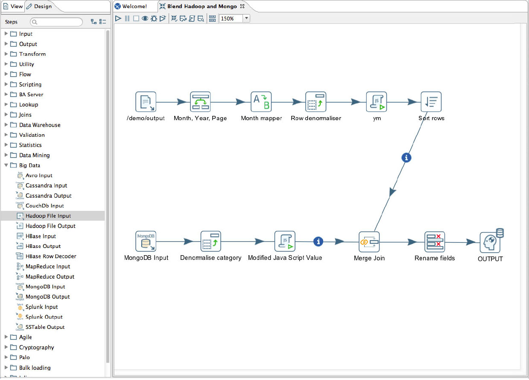
Pentaho Data Integration: Environment
Notes:
Each component is discussed individually below:
Data Source Layer
This represents the different data sources that feed data into the data warehouse. The data source can be of any format -- plain text file, relational database, other types of database, Excel file, etc., can all act as a data source.
Many different types of data can be a data source:
Operations -- such as sales data, HR data, product data, inventory data, marketing data, systems data.
Web server logs with user browsing data.
Internal market research data.
Third-party data, such as census data, demographics data, or survey data.
All these data sources together form the Data Source Layer.
Data Extraction Layer
Data gets pulled from the data source into the data warehouse system. There is likely some minimal data cleansing, but there is unlikely any major data transformation.
Staging Area
This is where data sits prior to being scrubbed and transformed into a data warehouse / data mart. Having one common area makes it easier for subsequent data processing / integration.
ETL Layer
This is where data gains its "intelligence", as logic is applied to transform the data from a transactional nature to an analytical nature. This layer is also where data cleansing happens. The ETL design phase is often the most time-consuming phase in a data warehousing project, and an ETL tool is often used in this layer.
Data Storage Layer
This is where the transformed and cleansed data sit. Based on scope and functionality, 3 types of entities can be found here: data warehouse, data mart, and operational data store (ODS). In any given system, you may have just one of the three, two of the three, or all three types.
Data Logic Layer
This is where business rules are stored. Business rules stored here do not affect the underlying data transformation rules, but do affect what the report looks like.
Data Presentation Layer
This refers to the information that reaches the users. This can be in a form of a tabular / graphical report in a browser, an emailed report that gets automatically generated and sent everyday, or an alert that warns users of exceptions, among others. Usually an OLAP tool and/or a reporting tool is used in this layer.
Metadata Layer
This is where information about the data stored in the data warehouse system is stored. A logical data model would be an example of something that's in the metadata layer. A metadata tool is often used to manage metadata.
System Operations Layer
This layer includes information on how the data warehouse system operates, such as ETL job status, system performance, and user access history.

Slide 30
Design Basic Transformation using PDI

Slide 31
Anatomy of Pentaho Transformation

Slide 32
Transformation
In Pentaho – a Transformation can be graphically defined using -
Transformation Steps
Hops used to connect all steps
Transformations are designed to read data from source and perform (cleansing, enriching and transforming data ) operations and finally take it to its destination.
A transformation may have many possible start places and all steps execute in parallel. If a step has a step before it, it will take the data in there, and use it.

Slide 33
Transformation Steps
A step is one part of a transformation. Steps can provide you with a wide range of functionality ranging from reading text-files to implementing slowly changing dimensions.
In a nutshell – transformation steps are connectors / components in your Pentaho transformation which
Connects / extract data from wide variety of file formats & databases
Helps you perform transformations on your data ( cleansing records, sorting, adding colums)
Connects to wide variety of files formats / databases as target systems
Out of box – PDI provides 300+ transformation steps

Slide 34
Hops
A hop connects one transformation step or job entry with another. The direction of the data flow is indicated with an arrow on the graphical view pane. A hop can be enabled or disabled (for testing purposes for example)
Transformation Hops
When a hop is disabled in a transformation, the steps that follow the disabled hop are cut off from any data flowing upstream of the disabled hop. This may lead to unexpected results when editing the downstream steps. For example, if a particular step-type offers a "Get Fields" button, clicking the button may not reveal any of the incoming fields as long as the hop is still disabled.

Slide 35
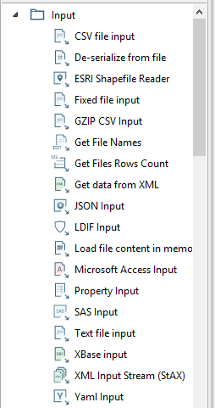
Working with Files
PDI offers steps to connect with variety of file formats…
These steps are used for input and output from / to files
Under file management – complete set of copy, delete, archive, directory listing is available
1) XML files | 6) Json
2) Delimited | 7) Microsoft Access
3) Excel | 8) LDIF
4) Full row | 9) Email
5) Positional | 10) Property Input

Slide 36
Day 2 Agenda
Working with Databases
Design Jobs using PDI
Metadata Injection
Using Pentaho Variables
Assignment

Slide 37
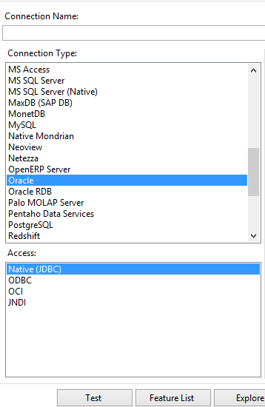
Working with Databases
These components are used for performing operations on RDBMS
We’ll now design few jobs to perform operations on MySQL database…
1) AS400 | 8) MS SQL Server
2) Access | 9) MySQL
3) AmazonRDS | 10) MongoDB
4) Cassandra | 11) Netezza
5) DB2 | 12) Oracle
6) Greenplum | 13) PostGreSQL
7) JavaDB | 14) SQLLite

Slide 38
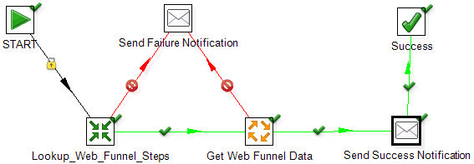
Job
Job manage the transformations. A job is made of transformations. The job define in which order the transformation are going to be called. For instance you first need to update all the dimensions tables before updating the facts table in an olap cube.
A job has one start place, and executes one step at a time, with one flow through the steps.

Slide 39
…
Job Hops
Besides the execution order, a hop also specifies the condition on which the next job entry will be executed. You can specify the evaluation mode by right clicking on the job hop:
"Unconditional" specifies that the next job entry will be executed regardless of the result of the originating job entry.
"Follow when result is true" specifies that the next job entry will only be executed when the result of the originating job entry was true, meaning successful execution, file found, table found, without error, evaluation was false, ...
"Follow when result is false" specifies that the next job entry will only be executed when the result of the originating job entry was false, meaning unsuccessful execution, file not found, table not found, error(s) occurred, evaluation was false, ...

Slide 40
Metadata Injection

Slide 41
What is Metadata Injection
ETL Metadata Injection, which is capable of inserting metadata into a template transformation. So instead of statically entering ETL metadata in a step dialog, you can pass it dynamically. This feature certainly plays an instrumental role in solving repetitive ETL workloads like loading of text files, data migration and so on.
Metadata injection inserts data from various sources into your transformation at runtime. This insertion reduces repetitive ETL tasks for various input and output files.

Slide 42
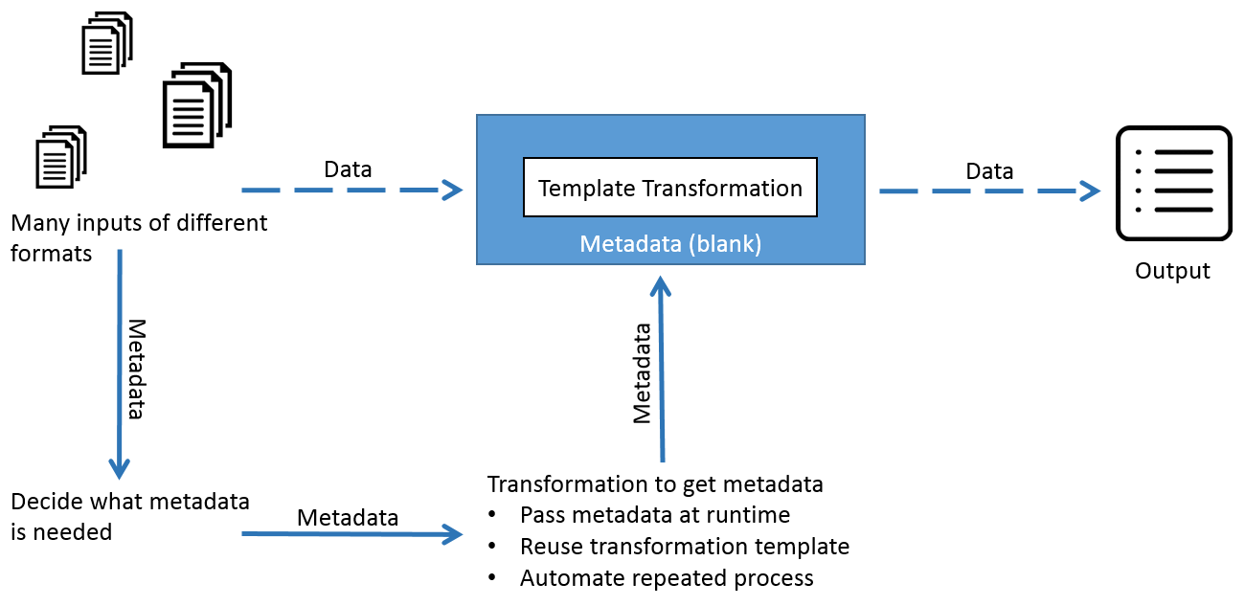
What is Metadata Injection

Slide 43
Steps which support Metadata Injection
https://help.pentaho.com/Documentation/7.1/0L0/0Y0/0K0/ETL_Metadata_Injection/Steps_Supporting_MDI

Slide 44
Using Pentaho Variables

Slide 45
Arguments, Parameters, and Variables
PDI has three paradigms for storing user input: arguments, parameters, and variables. Each is defined below, along with specific tips and configuration information.
Arguments
Parameters
Variables

Slide 46
Arguments
A PDI argument is a named, user-supplied, single-value input given as a command line argument (running a transformation or job manually from Pan or Kitchen, or as part of a script). Each transformation or job can have a maximum of 10 arguments. Each argument is declared as space-separated values given after the rest of the Pan or Kitchen line:
sh pan.sh -file:/example_transformations/example.ktr argOne argTwo argThree
In the above example, the values argOne, argTwo, and argThree are passed into the transformation, where they will be handled according to the way the transformation is designed. If it was not designed to handle arguments, nothing will happen. Typically these values would be numbers, words (strings), or variables (system or script variables, not PDI variables).
In Spoon, you can test argument handling by defining a set of arguments when you run a transformation or job. This is accomplished by typing in values in the Arguments fields in the Execute a Job or Execute a Transformation dialogue.

Slide 47
Parameters
Parameters are like local variables; they are reusable inputs that apply only to the specific transformation that they are defined in. When defining a parameter, you can assign it a default value to use in the event that one is not fetched for it. This feature makes it unique among dynamic input types in PDI.
Note: If there is a name collision between a parameter and a variable, the parameter will take precedence.
To define a parameter, right-click on the transformation workspace and select Transformation settings from the context menu (or just press Ctrl-T), then click on the Parameters tab.

Slide 48
Variables
A variable in PDI is a piece of user-supplied information that can be used dynamically and programmatically in a variety of different scopes. A variable can be local to a single step, or be available to the entire JVM that PDI is running in.
PDI variables can be used in steps in both jobs and transformations. You define variables with the Set Variable step in a transformation, by hand through the kettle.properties file, or through the Set Environment Variables dialogue in the Edit menu.
TheGet Variable step can explicitly retrieve a value from a variable, or you can use it in any PDI text field that has the diamond dollar sign File:/variable.png icon next to it by using a metadata string in either the Unix or Windows formats:
${VARIABLE}
%%VARIABLE%%

Slide 49
Variables
Both formats can be used and even mixed. In fact, you can create variable recursion by alternating between the Unix and Windows syntaxes. For example, if you wanted to resolve a variable that depends on another variable, then you could use this example: ${%%inner_var%%}.
Note: If there is a name collision with a parameter or argument, variables will defer.
You can also use ASCII or hexidecimal character codes in place of variables, using the same format: $[hex value]. This makes it possible to escape the variable syntax in instances where you need to put variable-like text into a variable.
For instance if you wanted to use ${foobar} in your data stream, then you can escape it like this: $[24]{foobar}. PDI will replace $[24] with a $ without resolving it as a variable.

Slide 50
Variables Scope
The scope of a variable is defined by the location of its definition. There are two types of variables: global environment variables, and Kettle variables. Both are defined below.
Environment Variables
Kettle Variables

Slide 51
Environment Variables
This is the traditional variable type in PDI. You define an environment variable through the Set Environment Variables dialogue in the Edit menu, or by hand by passing it as an option to the Java Virtual Machine (JVM) with the -D flag.
Environment variables are an easy way to specify the location of temporary files in a platform-independent way; for example, the ${java.io.tmpdir} variable points to the /tmp/ directory on Unix/Linux/OS X and to the C:\Documents and Settings\<username\Local Settings\Temp\ directory on Windows.
The only problem with using environment variables is that they cannot be used dynamically. For example, if you run two or more transformations or jobs at the same time on the same application server, you may get conflicts. Changes to the environment variables are visible to all software running on the virtual machine.

Slide 52
Kettle Variables
Kettle variables provide a way to store small pieces of information dynamically in a narrower scope than environment variables. A Kettle variable is local to Kettle, and can be scoped down to the job or transformation in which it is set, or up to a related job.
The Set Variable step in a transformation allows you to specify the related job that you want to limit the scope to; for example, the parent job, grandparent job, or the root job.

Slide 53
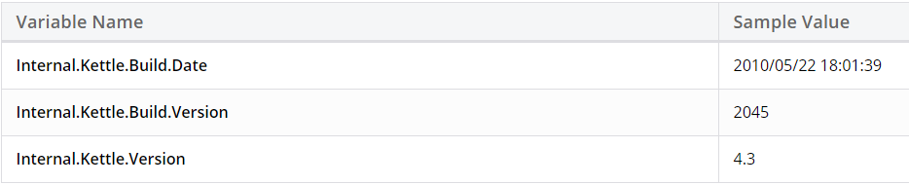
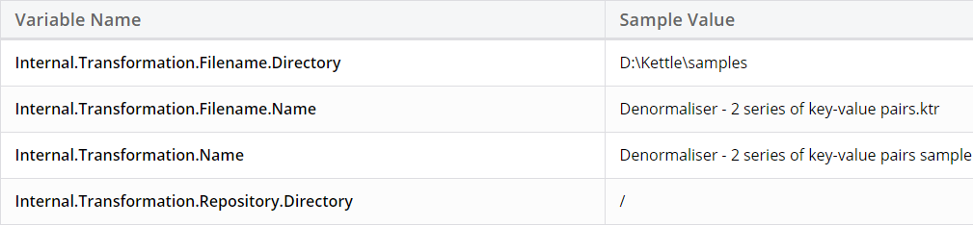
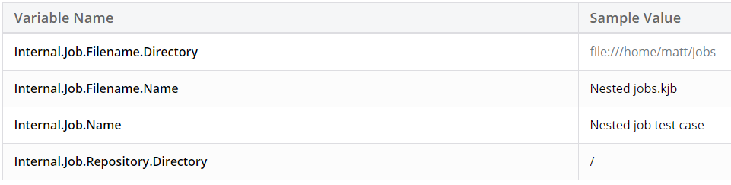
Kettle Internal Variables

Slide 54
Assignments

Slide 55
Day 3 Agenda
Log & Error Handling
Clustering & Parallel Execution
PDI Performance Tuning
Embedding Pentaho Data Integration
Assignment

Slide 56
Logging in Pentaho

Slide 57
Enable Logging
The logging functionality in Data Integration enables you to more easily troubleshoot complex errors and failures, and measure performance. To turn on logging in Data Integration, follow the below procedure.
Create a database or table space called pdi_logging.
Start Spoon, and open a transformation or job for which you want to enable logging.
Go to the Edit menu and select Settings... The Settings dialog appears.
Select the Logging tab.

Slide 58
Enable Logging
In the list on the left, select the function you want to log
Click the New button next to the Log Connection field. The Database Connection dialogue appears.
Enter your database connection details, then click Test to ensure that they are correct. Click OK when you are done.
Look through the list of fields to log, and ensure that the correct fields are selected.

Slide 59
Log Levels
When you run a job or transformation that has logging enabled, you have the option of choosing the log verbosity level in the execution dialogue:
Nothing Do not record any output
Error Only show errors
Minimal Only use minimal logging
Basic This is the default level
Detailed Give detailed logging output
Debug For debugging purposes, very detailed output
Row level Logging at a row level. This will generate a lot of log data
If the Enable time option is enabled, all lines in the logging will be preceded by the time of day.

Slide 60
Log Rotation
This procedure assumes that you do not have or do not want to use an operating system-level log rotation service.
If you are using such a service on your Pentaho server, connect to the BA Server and Data Integration Server and use that instead of implementing this solution.
The Business Analysis and Data Integration servers use the Apache log4j Java logging framework to store server feedback.
The default settings in the log4j.xml configuration file may be too verbose and grow too large for some production environments.
Follow these instructions to modify the settings so that Pentaho server log files are rotated and compressed.

Slide 61
Log Rotation
Stop all relevant Pentaho servers
Download a .zip archive of the Apache Extras Companion for log4j package: Apache Logging Services.
Unpack the apache-log4j-extras JAR file from the zip archive, and copy it to the following locations:
Business Analytics Server: /tomcat/webapps/pentaho/WEB-INF/lib/
Data Integration Server: /tomcat/webapps/pentaho-di/WEB-INF/lib/

Slide 62
Log Rotation
Edit the log4j.xml settings file for each server that you are configuring. The files are in the following locations:
BA Server: /tomcat/webapps/pentaho/WEB-INF/classes/
DI Server: /tomcat/webapps/pentaho-di/WEB-INF/classes/
Remove all PENTAHOCONSOLE appenders from the configuration
Modify the PENTAHOFILE appenders to match the log rotation conditions that you prefer. You may need to consult the log4j documentation to learn more about configuration options. Two examples that many Pentaho customers find useful are listed:Daily (date-based) log rotation with compression:

Slide 63
Log Rotation
Edit the log4j.xml settings file for each server that you are configuring. The files are in the following locations:
BA Server: /tomcat/webapps/pentaho/WEB-INF/classes/
DI Server: /tomcat/webapps/pentaho-di/WEB-INF/classes/
Remove all PENTAHOCONSOLE appenders from the configuration
Modify the PENTAHOFILE appenders to match the log rotation conditions that you prefer. You may need to consult the log4j documentation to learn more about configuration options. Two examples that many Pentaho customers find useful are listed:Daily (date-based) log rotation with compression:

Slide 64
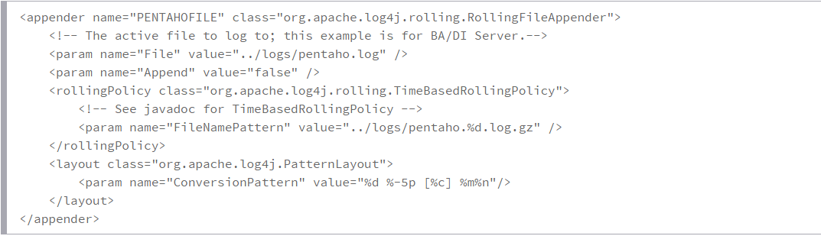
Log Rotation – Date Based

Slide 65
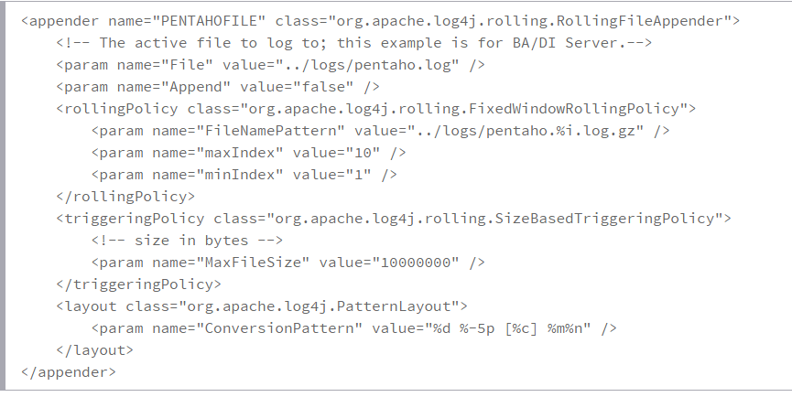
Log Rotation – Size Based

Slide 66
Best Practices for Kettle Logging
Kettle logging provides extensive flexibility that allows you to determine log locations, granularity, as well as what information is captured. Here are a best practices for setting up logging in your environment.
Store logs in a centralized database. By default, log files are stored locally. Spoon, Carte, and DI Server logs are stored separately. To make log information easier to find, place logs in a central database. As an added bonus, centralized logging makes it easier to use PDI’s performance monitoring more effectively.
Obtain Full Insert Accesses for Tables. Logging can fail if you do not have the appropriate accesses. Having the appropriate accesses minimizes this risk. To learn more about table access, consult the documentation for your database.

Slide 67
Best Practices for Kettle Logging
Use Implied Schemas When Possible. Implied schemas result in fewer places to troubleshoot should logging fail. Of course, you can still specify a schema if needed.
Make templates for transformation and job files. Include logging configurations in the template so that they can be reused with ease.
Use Kettle Global Logging Variables When Possible. To avoid the work of adding logging variables to each transformation or job, consider using global logging variables instead. You can override logging variables by adding information to individual transformations or jobs as needed.

Slide 68
Use Kettle Global Logging Variables
KETTLE_TRANS_PERFORMANCE_LOG_TABLE=trans_performance KETTLE_CHANNEL_LOG_DB=OracleDB_Connection KETTLE_JOB_LOG_DB=OracleDB_Connection KETTLE_LOG_SIZE_LIMIT= KETTLE_TRANS_LOG_TABLE=trans KETTLE_TRANS_ROWSET_SIZE=0 KETTLE_TRANS_PERFORMANCE_LOG_DB=OracleDB_Connection KETTLE_MAX_LOG_TIMEOUT_IN_MINUTES=10 KETTLE_EMPTY_STRING_DIFFERS_FROM_NULL=N KETTLE_JOB_LOG_TABLE=job KETTLE_JOBENTRY_LOG_DB=OracleDB_Connection KETTLE_MAX_LOG_SIZE_IN_LINES=10000 KETTLE_CHANNEL_LOG_TABLE=channel KETTLE_TRANS_LOG_DB=OracleDB_Connection KETTLE_JOBENTRY_LOG_TABLE=job_entry KETTLE_STEP_LOG_DB=OracleDB_Connection KETTLE_STEP_LOG_TABLE=step KETTLE_STEP_PERFORMANCE_SNAPSHOT_LIMIT=0

Slide 69
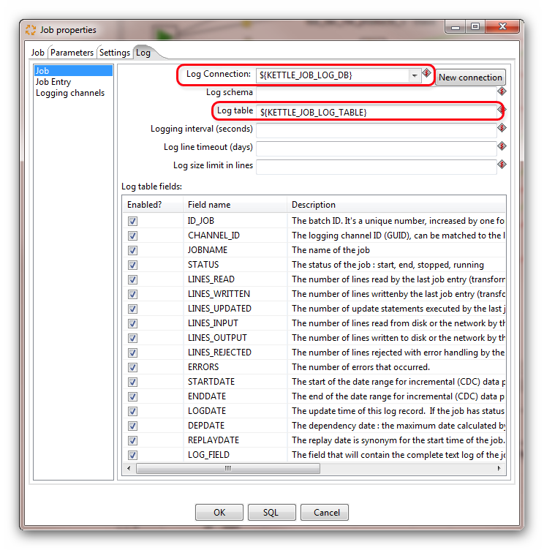
Use Kettle Global Logging Variables

Slide 70
Moving your Logging to Carte or BI Server
This assumes that you have created a JNDI connection in Spoon with the same name as the connections on your server. Also, you’ve verified the connections work and have all the appropriate database drivers.
Make sure you move the kettle.properties file you’ve already configured locally to the server in the appropriate user folder and the .kettle folder as illustrated above. You’ll have to shutdown and restart the server since you are adding new environment variables to the server instance.
Now that everything is configured locally, on the sever and we’ve made the appropriate changes to the solution files, we can move the solutions to the server. Simply move them to Carte or for the BI Server, move the solution files with corresponding XACTIONs that execute the solution files. You’ll have to refresh the repository as necessary.
Execute the solutions on the server. All logging should go to the exact same place locally as well as remotely.

Slide 71
Note:
Make a template for both Job and Transformation files with all the appropriate logging configuration setup.
This way you don’t have to make them over and over again. If you have one job executing other jobs, it will pick up the logging of the children jobs.
If executed alone, it will not. The master job will not pick up the transformation logging unless specified in the file itself.

Slide 72
Please Note…
Since PDI is designed to be platform agnostic, the logging table mechanism attempts to find a happy medium between all databases. However, there are some database specific things up you must do especially if you’re processing a lot of data to avoid concurrency issues and you may get a table lock
The problem
All that Kettle wants to do is generate a unique integer ID at the very start of the transformation or job. That "batch" ID is then being used in various places throughout the life of the transformation or job. Unfortunately, generating a unique ID is not something that is handled in any sort of standard fashion by the various database vendors.

Slide 73
…
Whatever the case, Kettle opted in the early beginning to stay on the safe path and simply insert look in a log table to calculate the maximum ID to then add one to it. This works fine until more than one transformation or job runs at the same time. At that point you can be looking at the very same maximum ID value with 2 different database connections. This in turn gives you duplicate values in the log tables.

Slide 74
The Solution
Use an identity column
You can use an identity or auto-increment column if your database supports this. To enable support, create a new table like this (MySQL example):
create table LOG_COUNTER(ID INTEGER NOT NULL AUTO_INCREMENT PRIMARY KEY, NAME VARCHAR(100)) engine=InnoDB;
insert into LOG_COUNTER(NAME) values('LOG_TABLES');
commit;
In the logging database connection in Pentaho Data Integration (Spoon), add the following line in the Options pane:
Parameter: AUTOINCREMENT_SQL_FOR_BATCH_ID
Value: UPDATE LOG_COUNTER SET ID=LAST_INSERT_ID(ID+1)
This will explain to PDI to use a value from the LOG_COUNTER table every time a new batch ID needs to be generated for a transformation or a job table.

Slide 75
The Solution
Use a SEQUENCE column
You can use a database sequence if your database supports this. To enable support for this, create a sequence like this (Oracle example):
CREATE SEQUENCE LOGGINGSEQ START WITH 10000;
In the logging database connection in Pentaho Data Integration (Spoon), add the following line in the Options panel:
Parameter: SEQUENCE_FOR_BATCH_ID
Value: LOGGINGSEQ
This will explain to PDI to use a value from the LOGGINGSEQ sequence every time a new batch ID needs to be generated for a transformation or a job table.

Slide 76
Best Practices kettle.properties
Backup your kettle.properties files. If you are making many changes to the Kettle.properties file, consider backing up the file first. This will make it easier to restore should issues occur
Maintain a Master Copy of the kettle.properties file. It is usually easiest to use the kettle.properties file for Spoon, then to overwrite the Carte and DI Server copies if changes are made. Make sure that values that might change, such as directory paths, are maintained however
Test Thoroughly. Test your settings by saving your kettle.properties file locally, then restarting spoon. Make sure the kettle.properties file loads properly. Execute a transformation or job that uses the settings. Try executing the transformation locally and remotely on the DI Server to ensure that log variables reference the same places.

Slide 77
Error Handling Strategies
Pentaho job should die gracefully, notifying the operations team and leaving the data in a good state…
We are going to discuss three strategies
Do Nothing
For simple jobs, say an automated administrative task, you can rely on the exception throwing of PDI.
An example is a simple input to output job where a database failure in writing the output results in a system error. This is expressed as a red stack trace in log file.

Slide 78
Error Handling Strategies
Error Handling Triggers
Each step and transformation has a return code that can drive additional processing.
The Error Handling setting / Error Hop can be used to steer the error toward an error handling routine like the Mail component.
Both an individual transformation and a finer-grain step can be tested.
While testing the individual transformation and steps has the advantage of providing error handling tied to the specific case, there are disadvantages in maintenance and testing.
Maintenance suffers because the job becomes cluttered with extra components which can confuse the normal processing, less frequent processing, and the error handling. Testing is harder because there are more test cases.

Slide 79
Pentaho Data Integration Performance Tuning

Slide 80
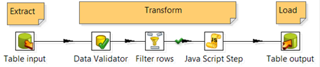
Performance Tuning Process
PDI transformations are ETL workflows that consist of a number of steps linked together as show below. There are three basic types of steps:
Input step – ingests data into PDI (e.g. Table input step).
Transformation step – processes data within PDI (e.g. Data Validator, Filter rows, and Java Script Step steps).
Output step – outputs transformed data from PDI (e.g. Table output step).

Slide 81
Internal vs. External Performance Factors
If the bottleneck is an input or output step then it is likely due to something external to PDI, such as network or database performance. If the bottleneck is a transformation step then it is likely due to PDI performance. Many factors can affect performance and this guide groups them into two sections: External Performance Factors and PDI Performance Tuning.
Identifying Bottlenecks
Step Metrics
A row buffer is created between each step. Steps retrieve rows of data from their inbound row buffer, process the rows, and pass them into an outbound row buffer which feeds into the subsequent step. By default, row buffers can hold up to 10,000 rows, but this can be configured for each transformation.

Slide 82
Internal vs. External Performance Factors
When you run a transformation, the Step Metrics tab on the Execution Results pane shows real-time statistics for each step. The input/output field shows a real-time display of the number of rows in the buffers feeding into and coming out of each step. If the input buffer of a step is full then you know that the step cannot keep up with the rows being fed into it. Below are some examples.
The example above shows a snapshot in time of a running transformation. Since all of the buffers are low (much less than 10,000) it is clear that the transformation has no trouble keeping up with incoming rows, processing them and delivering to the target.
Step Name | Table Input | Data Validator | Filter Rows | JavaScript Step | Table Output
Input/Output | 0/50 | 48/52 | 54/42 | 37/51 | 43/0

Slide 83
Internal vs. External Performance Factors
The example below shows that all the buffers are full (close to the buffer size of 10,000). This means that PDI is waiting for the Table output step to consume rows. The data target is the bottleneck.
The example below shows that the row buffers are filled all the way through to the Java Script Step. The Table output buffers are low which indicates that the data target has no trouble consuming output from PDI. This indicates that the Java Script Step is the bottleneck.
Step Name | Table Input | Data Validator | Filter Rows | JavaScript Step | Table Output
Input/Output | 0/9720 | 9850/9741 | 9922/9413 | 9212/9413 | 9985/0
Step Name | Table Input | Data Validator | Filter Rows | JavaScript Step | Table Output
Input/Output | 0/9815 | 9784/9962 | 9834/9724 | 9834/27 | 53/0

Slide 84
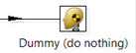
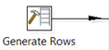
Verifying Bottlenecks
You can verify that the bottleneck is an output step by replacing the output step with a dummy step which just throws away the rows. If the overall speed of the transformation increases then it is likely that the output step is the bottleneck.
For input step bottlenecks, you can replace the input step with a Generate Rows step, Data Grid step, or a Text file input step pointing to a file on fast local storage or a RAM drive. Check if the transformation is faster.

Slide 85
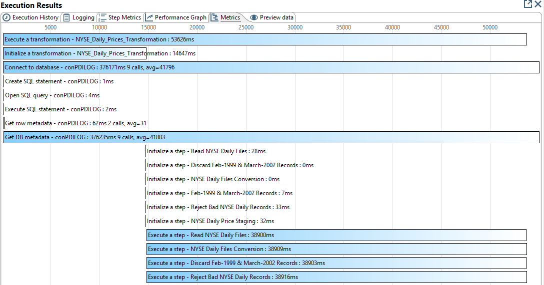
Eliminating the bottleneck
The Metrics tab on the Execution Results pane shows the length of time in milliseconds for initialization and execution of each transformation step and can also assist with identifying bottlenecks.

Slide 86
External Performance Factors
PDI is, by its nature, part of a larger system that includes data sources, data targets, networking, storage, and other infrastructure components. This guide discusses these areas at a high level but does not provide detailed tuning instructions such as how to tune your Oracle database.
Network Performance
Many times the network is the bottleneck and no matter how much hardware you throw at your database or PDI server, throughput is capped by the network layer. The following techniques can assist with addressing network bottlenecks:

Slide 87
External Performance Factors
Diagnosis - determine if the network is the bottleneck by eliminating it altogether. Export source data to a local text file and measure how long it takes for the database to export the data without touching the network. Then copy the text file to the PDI server and measure the time for the transfer. Modify the transformation to import the local file. Then run the transformation again and measure the time to import the local file without touching the network. Compare these measurements to assess network performance.
Network sizing – Consider adding additional NIC’s or upgrading to 10gbps. Scale out data sources/targets and/or PDI using clustering technology which leverages network connectivity across multiple servers (see below for more on PDI clusters). Ethernet bonding can provide increased throughput as well as failover.

Slide 88
External Performance Factors
Network bottlenecks - switches, routers, proxy servers, firewalls, and other network appliances can create bottlenecks. Consider upgrading or bypassing these altogether
WAN optimization – moving data across a WAN presents a number of challenges. Consider moving data sources, data targets, and/or PDI servers to be on the same LAN. If you must move data across a WAN there are a number of techniques and third-party appliances designed to improve throughput. One alternative to direct database connections is to dump data to a text file and performing a file transfer using a WAN optimized tool such as ExpeDat (http://www.dataexpedition.com/expedat) See http://en.wikipedia.org/wiki/WAN_optimization for more info.

Slide 89
External Performance Factors
Cloud Computing – network configuration in the cloud can be tricky due to the lack of transparency of the implementation. Some things to consider with AWS include (see http://aws.amazon.com/ec2/instance-types/ ):

Slide 90
Data Source/Target Performance
If the network is not the bottleneck then it may be the performance of the data source or target. Database optimization is an advanced topic with many techniques that vary greatly from one product to the next. Some common approaches are listed below
Query optimization – this is almost always the first place to start. Many databases provide a SET EXPLAIN feature that allows you to determine whether indexes are being used or if the database is performing a complete table scan. Constraints and triggers can also affect performance.
Local Export/Import – import or export a local text file or pipe to /dev/null and measure throughput. This may represent the fastest throughput possible for the data source/target.

Slide 91
Data Source/Target Performance
Data Staging/Pre-processing – consider creating a materialized view or pre-processing data on the database and/or loading a staging table. These approaches can simplify the ETL logic and possibly reduce data volume over the network.
Database Technologies – Hadoop, NoSQL, analytical, multi-dimensional, in-memory, cache, and other database technologies may provide better performance for certain situations.
Replication – database replication may allow a mirror image of a database to be kept physically close to PDI. This can reduce or even eliminate network connectivity between PDI and the data source/target.

Slide 92
Data Source/Target Performance
Database design – star schemas and other data mart design patterns can dramatically improve performance at the cost of additional complexity and resources.
Clustering/Sharding/Partitioning – some databases support table partitioning or database sharding that can improve performance for certain types of queries. PDI has functionality for configuring transformations to leverage these features. See the PDI Clusters section below for more information on how to leverage these features.

Slide 93
PDI Performance Tuning
This section provides techniques for tuning various aspects of PDI, including:
PDI Transformation Design
PDI Job Design
Scaling Up Transformations
PDI Clusters
PDI Visual Map/Reduce for Hadoop

Slide 94
PDI Performance Tuning
PDI Transformation Design
Data Caching
High network latency can make executing multiple queries much slower than running a single bulk query. Most lookup steps allow you cache lookup values. You can even perform up-front loading of records in a single query and cache all results instead of performing multiple queries.
Batch Updates
Batch updates can also reduce the number of queries. The commit size setting controls the size of the batches. See documentation on the table output step for additional info around using batch updates.

Slide 95
PDI Performance Tuning
Database Processing
Database Sorting: Sorting on the database is often faster than sorting externally, especially if there is an index on the sort field(s). See the Memory section below for configuring the Sort rows step to leverage memory and CPU resources.
Database Processing: In some cases, performance will be better if data is processed directly on the database. This approach may completely eliminate the need for a PDI transformation. Data can be pre-processed or staged on the database to simplify PDI transformations. Transformation logic can also be moved to the target sources in an Extract/Load/Transform (ELT) design pattern. Stored procedures, triggers, materialized views, and aggregation tables are just some of the techniques that can be leveraged.

Slide 96
PDI Performance Tuning
Prepared Statements: Most database steps prepare statements which incur some overhead up front but improve performance overall. The Execute SQL Script, Execute row SQL script, and Dynamic SQL row steps do not perform this initial statement preparation and may not perform as well.

Slide 97
PDI Performance Tuning
Scripting
The JavaScript step provides enormous flexibility however it may not perform as well as other highly optimized, single-purpose transformation steps.
Turn off compatibility mode when not needed. This will run the newer, faster JavaScript engine.
Consider writing a step plugin. This can provide better performance than using a JavaScript step.
A User Defined Java Class step may perform better than a JavaScript step.

Slide 98
PDI Performance Tuning
Constant/Static Values
Avoid calculating the same static value on every row. Instead you can calculate constants in a separate transformation and set variables to be used in downstream transformations. Or you can calculate constants in a separate stream and use the Join Rows (Cartesian product) step to join the constant into the main stream.

Slide 99
PDI Performance Tuning
Text files - CSV file input, Text file input, Text file output transformation steps
The Lazy conversion setting will postpone data conversion as long as possible. This includes character decoding, data conversion, trimming, etc. This can be helpful if not all fields are used, if data will be simply written out to another text file, or in some bulk loader scenarios.
The NIO buffer size parameter determines the amount of data read at once from a text file. This can be adjusted to increase throughput.

Slide 100
PDI Performance Tuning
Logging and Performance Monitoring
Detailed logging and performance monitoring can be very helpful in development and test environments. The logging level can be turned down and performance monitoring can be disabled for production environments to conserve resources.

Slide 101
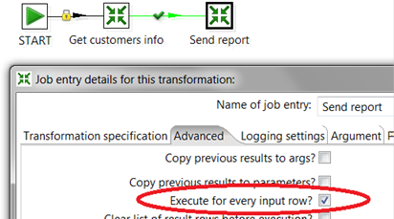
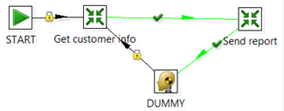
PDI Job Design
Looping
Avoid creating loops in PDI jobs. In the example below the Get customer info transformation gets a customer record and then the Send report transformation sends a report to that customer. The Send report transformation continues to the DUMMY job entry which then loops back to Get customer which retrieves the next customer and the loop continues until there is no data left.

Slide 102
PDI Job Design
Database Connection Pooling
There is some overhead with establishing new database connections at run time. Enable connection pooling to maintain a pool of open connections that can be used as needed by the job or transformation.
Checkpoints
You can specify checkpoints in your jobs and restart jobs from the last successful checkpoint. This avoids having to re-start jobs from the beginning in case of failure.

Slide 103
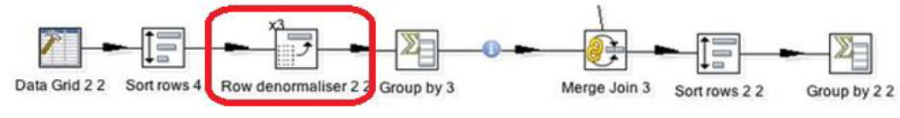
PDI Job Design
CPU and Multithreading
PDI transformations are multithreaded. Each step in a transformation gets its own thread. Transformation steps run in parallel, leveraging multiple cores.
You can increase the number of copies of a step to increase threads assigned to the step. This allows you to assign more CPU resources to slower steps. In the example below, the Row denormalizer step is assigned three step copies which will spawn three threads. Each of the other steps will spawn its own thread. Therefore, transformation will spawn a total of 9 threads which could utilize up to 9 cores on the PDI server.

Slide 104
PDI Job Design
The Blocking Step and Block this step until steps finish steps allow you to pause downstream steps until previous steps have completed. This may be necessary for the logic to function properly but it may increase the overall time for the transformation to complete as well as require more memory as the row buffers will fill up with results from all rows before proceeding.
PDI job entries normally run sequentially. You can configure the job to run two or more transformations in parallel.
Combining two or more transformations into a single transformation will run all steps in parallel.

Slide 105
PDI Job Design
Memory Utilization
Many PDI transformation steps allow you to control how memory is utilized. Allocating more memory to PDI in conjunction with fine tuning step settings can have a big impact on performance.
A row buffer is created between each step. You can configure the size of the buffer (in rows): go to Transformation settings, Miscellaneous tab, and modify the Nr of rows in rowset Row buffers are stored in memory so this setting allows you to increase or decrease memory used for the buffers.
Sorting all rows in memory is significantly faster than using a memory-plus-disk approach. Use the Sort size (rows in memory) setting on the Sort rows step to control this. The Free memory threshold (in %) helps avoid filling up available memory. Be sure to allocate enough RAM to PDI. The Compress TMP Files setting can also conserve memory at the cost of CPU resources.

Slide 106
PDI Job Design
Several join and lookup steps allow you to configure data caching which can reduce the number of database queries. This can improve performance at the cost of using more memory. Some configuration settings allow you to control cache size.

Slide 107
Few more Tips…
Distribution of Data: Change Number of Copies to Start-This Step is helpful for distributed architecture i.e. if your system has multiple processors, this step will use each of them efficiently for a particular selected step. In order to select this, Right Click on any Step of Transformation.
Now to see this option, you can change the default value (which is 1) to something more.
Value=Number of processors-1
Make sure to set type of data movement (Right Click on a step) to 'Distribute'.
This step will partition the data in different sets and assign them internally to different processors. So, for a single step multiple sets of data would be handles in parallel among processors thus achieving parallelization.

Slide 108
Few more Tips…
Set some Commit Size: In any Output/Update set some Value of Commit Size rather than 0.This will reduce Buffer Load of storing uncommitted data.
However, it won’t be a reasonable value i.e. Matt Casters says 1000 commit size for every 5000 rows.
Saving Round-Trips to Database Server: Too save trips of fetching data from a database every time, one can set defaultRowprefetch(Goto Connection>Options) to a reasonable value.
By default it is 10 rows for Oracle. So this means every call to server will fetch 10 rows. Increase it 50 and you can reduce the database calls to 1/5.

Slide 109
Few more Tips…
Adjusting Queue Size: Adjusting No. of rows in row-set (Go-to Transformation Settings >Miscellaneous) to a reasonable value which your RAM can handle can significantly help performance.
This value should only be increased if the system has lot of RAM available. It would take much more rows in RAM, in buffer and processing will be much faster. However, to find the best suited value for it is by hit and trial.
Use Step Monitoring: Enable it (Transformation Settings>Monitoring) and find the performance statistics of the transformation then fine tune it accordingly.

Slide 110
Few more Tips…
Lazy Conversion: This is for good and better performance, especially when you need to write from an input text file to an output text file.
The step avoids any conversion happening to Binary data fetched from Input File and thus, uses serialization for writing data.
Removing Fields in Select Values step: Always avoid doing it as it reconstructs new rows. Thus it can directly affect performance.
Avoid Javascript as much as possible, even though it is the fastest scripting language it still requires javascript engine to work and thus is an overhead. If avoiding is not possible reduce it e.g. instead of 3 javascript steps use 1 step with combined script.
Avoid Data conversion and variable creation in Javascript as much as possible, as it can be handled by Pentaho kettle steps.

Slide 111
Embedding Pentaho Data Integration

Slide 112
Embedding Pentaho Data Integration
To integrate PDI transformations and jobs into your applications, embed PDI objects directly into your application code. The instructions in this section address common embedding scenarios.
You can get the accompanying sample project from the kettle-sdk-embedding-samples folder of the sample code package. The sample project is bundled with a minimal set of dependencies. In a real-world implementation, projects require the complete set of PDI dependencies that include all .jar files from data-integration/lib.
For each embedding scenario, there is a sample class that can be executed as a stand-alone java application. You can execute the classes manually or run the Ant targets provided in build/build.xml to run the sample classes.

Slide 113
Running Transformations
If you want to run a PDI transformation from Java code in a stand-alone application, take a look at this sample class, org.pentaho.di.sdk.samples.embedding.RunningTransformations.
It sets the parameters and executes the transformation in etl/parametrized_transformation.ktr.
The transform can be run from the .ktr file using runTransformationFromFileSystem() or from a PDI repository using runTransfomrationFromRepository().

Slide 114
Running Transformations
Always make the first call to KettleEnvironment.init() whenever you are working with the PDI APIs.
Prepare the transformation. The definition of a PDI transformation is represented by a TransMeta object. You can load this object from a .ktr file, a PDI repository, or you can generate it dynamically. To query the declared parameters of the transformation definition use listParameters(), or to query the assigned values use setParameterValue().
Execute the transformation. An executable Trans object is derived from the TransMeta object that is passed to the constructor. The Trans object starts and then executes asynchronously. To ensure that all steps of the Trans object have completed, call waitUntilFinished().
Evaluate the transformation outcome. After the Trans object completes, you can access the result using getResult(). The Result object can be queried for success by evaluating getNrErrors(). This method returns zero (0) on success and a non-zero value when there are errors. To get more information, retrieve the transformation log lines.

Slide 115
Running Jobs
If you want to run a PDI job from Java code in a stand-alone application, take a look at this sample class, org.pentaho.di.sdk.samples.embedding.RunningJobs. It sets the parameters and executes the job in etl/parametrized_job.kjb. The job can be run from the .kjb file using runJobFromFileSystem() or from a repository using runJobFromRepository().
Always make the first call to KettleEnvironment.init() whenever you are working with the PDI APIs..
Prepare the job. The definition of a PDI job is represented by a JobMeta object. You can load this object from a .ktb file, a PDI repository, or you can generate it dynamically. To query the declared parameters of the job definition use listParameters(). To set the assigned values use setParameterValue().
Execute the job. An executable Job object is derived from the JobMeta object that is passed in to the constructor. The Job object starts, and then executes in a separate thread. To wait for the job to complete, call waitUntilFinished().

Slide 116
Building Transformations Dynamically
To enable your application to respond quickly to changing conditions, you can build transformations dynamically.
The example class, org.pentaho.di.sdk.samples.embedding.GeneratingTransformations, shows you how. It generates a transformation definition and saves it to a .ktr file.
1) Always make the first call to KettleEnvironment.init() whenever you are working with the PDI APIs.
2) Create and configure a transformation definition object. A transformation definition is represented by a TransMeta object. Create this object using the default constructor. The transformation definition includes the name, the declared parameters, and the required database connections.

Slide 117
Building Transformations Dynamically
Populate the TransMeta object with steps. The data flow of a transformation is defined by steps that are connected by hops.
Create the step by instantiating its class directly and configure it using its get and set methods. Transformation steps reside in sub-packages of org.pentaho.di.trans.steps. For example, to use the Get File Names step , create an instance of org.pentaho.di.trans.steps.getfilenames.GetFileNamesMeta and use its get and set methods to configure it.
Obtain the step id string. Each PDI step has an id that can be retrieved from the PDI plugin registry. A simple way to retrieve the step id is to call PluginRegistry.getInstance().getPluginId(StepPluginType.class, theStepMetaObject).

Slide 118
Building Transformations Dynamically
Create an instance of org.pentaho.di.trans.step.StepMeta, passing the step id string, the name, and the configured step object to the constructor. An instance of StepMeta encapsulates the step properties, as well as controls the placement of the step on the Spoon canvas and connections to hops. Once the StepMeta object has been created, call setDrawn(true) and setLocation(x,y) to make sure the step appears correctly on the Spoon canvas. Finally, add the step to the transformation, by calling addStep() on the transformation definition object.
Once steps have been added to the transformation definition, they need to be connected by hops. To create a hop, create an instance of org.pentaho.di.trans.TransHopMeta, passing in the From and To steps as arguments to the constructor. Add the hop to the transformation definition by calling addTransHop().
After all steps have been added and connected by hops, the transformation definition object can be serialized to a .ktr file by calling getXML() and opening it in Spoon for inspection. The sample class org.pentaho.di.sdk.samples.embedding.GeneratingTransformations generates this transformation.

Slide 119
Building Jobs Dynamically
To enable your application to respond quickly to changing conditions, you can build jobs dynamically. The example class, org.pentaho.di.sdk.samples.embedding.GeneratingJobs, shows you how. It generates a job definition and saves it to a .kjb file.
Always make the first call to KettleEnvironment.init() whenever you are working with the PDI APIs.
Create and configure a job definition object. A job definition is represented by a JobMeta object. Create this object using the default constructor. The job definition includes the name, the declared parameters, and the required database connections.

Slide 120
Building Jobs Dynamically
Populate the JobMeta object with job entries. The control flow of a job is defined by job entries that are connected by hops.
Create the job entry by instantiating its class directly and configure it using its get and set methods. The job entries reside in sub-packages of org.pentaho.di.job.entries. For example, use the File Exists job entry, create an instance of org.pentaho.di.job.entries.fileexists.JobEntryFileExists, and use setFilename() to configure it. The Start job entry is implemented by org.pentaho.di.job.entries.special.JobEntrySpecial.
Create an instance of org.pentaho.di.job.entry.JobEntryCopy by passing the job entry created in the previous step to the constructor. An instance of JobEntryCopy encapsulates the properties of a job entry, as well as controls the placement of the job entry on the Spoon canvas and connections to hops. Once created, call setDrawn(true) and setLocation(x,y) to make sure the job entry appears correctly on the Spoon canvas. Finally, add the job entry to the job by calling addJobEntry() on the job definition object. It is possible to place the same job entry in several places on the canvas by creating multiple instances of JobEntryCopy and passing in the same job entry instance.

Slide 121
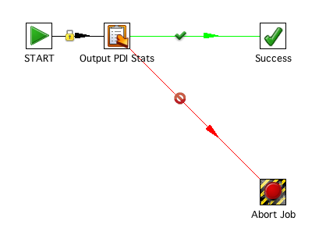
Building Jobs Dynamically
Once job entries have been added to the job definition, they need to be connected by hops. To create a hop, create an instance of org.pentaho.di.job.JobHopMeta, passing in the From and To job entries as arguments to the constructor. Configure the hop consistently. Configure it as a green or red hop by calling setConditional() and setEvaluation(true/false). If it is an unconditional hop, call setUnconditional(). Add the hop to the job definition by calling addJobHop().
After all job entries have been added and connected by hops, the job definition object can be serialized to a .kjb file by calling getXML(), and opened in Spoon for inspection. The sample class org.pentaho.di.sdk.samples.embedding.GeneratingJobs generates this job.

Slide 122
Running Jobs
Evaluate the job outcome. After the Job completes, you can access the result using getResult(). The Result object can be queried for success using getResult(). This method returns true on success and false on failure. To get more information, retrieve the job log lines.

Slide 123
Day 4 Agenda
Pentaho Administration
Case Study – Design Pentaho Step Plugin
Overview Pentaho Report Designer
Q & A session

Slide 124
Pentaho Administration Console

Slide 125
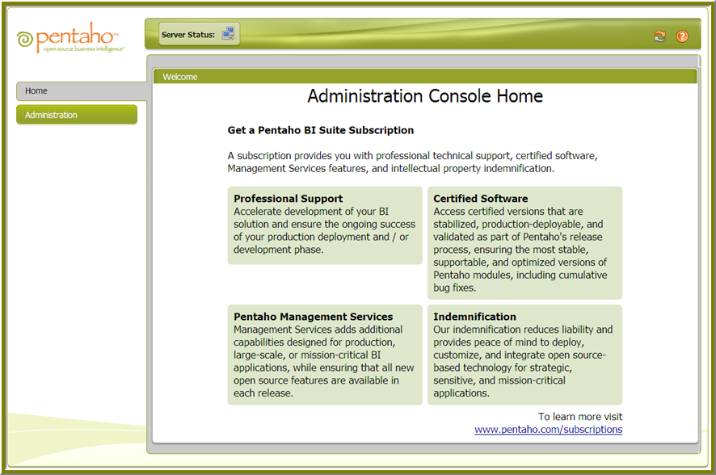
PAC
The Pentaho Administration Console provides you with a central location from which to administer your Pentaho deployments.
The console aggregates and simplifies many common administrative tasks such as managing users and roles, scheduling jobs, and managing services.
The Administration Console changes how you interact with your Pentaho deployments by automating some of the tasks that you now perform manually.

Slide 126
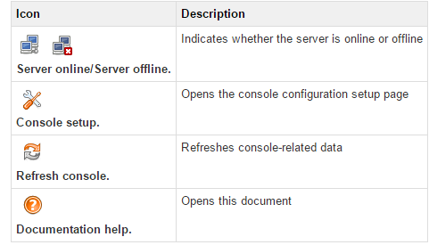
Overview of Console Components
Home
From your console home page (shown above), you are able access to important information about your Pentaho deployment. For example, status indicators appear in the tool bar when there is a critical error, a process that is currently running, or a warning you must research.
Console tool bar

Slide 127
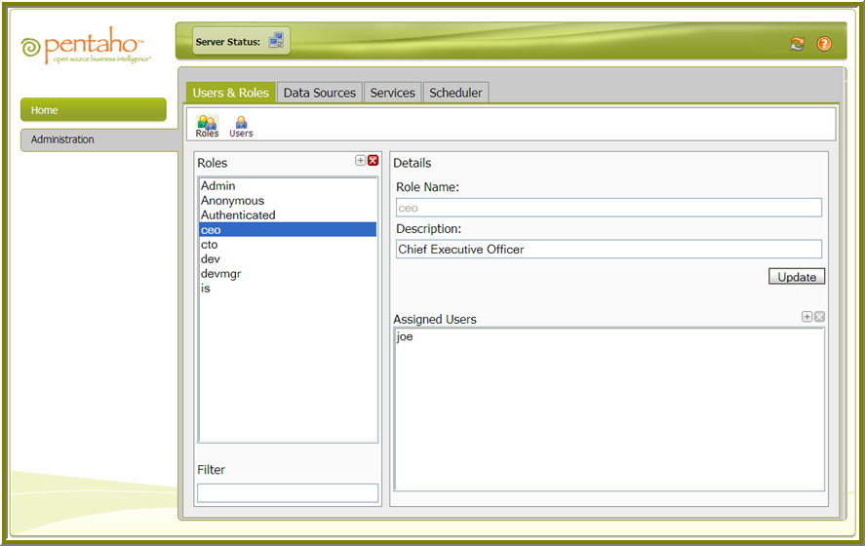
Administration
From the Administration page you can manage users and roles, define data sources, manage admin services, and manage public (subscription) and private (regular) schedules.

Slide 128
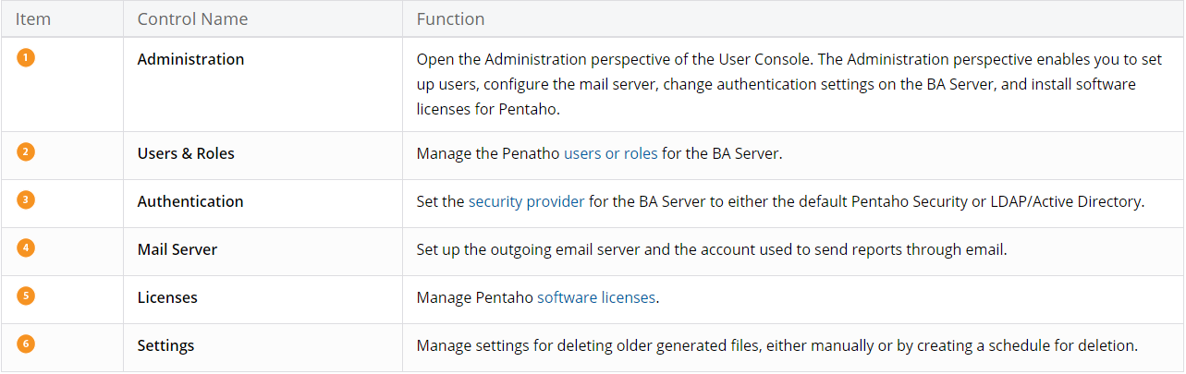
Administration

Slide 129
Managing Users and Roles
The Pentaho Pre-Configured Installation (PCI) includes sample data and a group of fictitious users. If you are new to Pentaho, you can use the Administration Console to manage real users (and roles) in the BI Platform without having to configure an LDAP-compliant directory such as MSAD (Microsoft Active Directory) while you are performing a proof of concept.
Adding Users
Follow the instructions below to add users to the BI Platform:
In the Administration Console go to Administration > Users & Roles.
Click the Users icon if you are not in Users mode.
Click the plus sign (+) next to Users.
In the Details pane, enter the User Name, Password, Password Confirmation, and Description.
Click OK. The new user's name appears in the list of users.

Slide 130
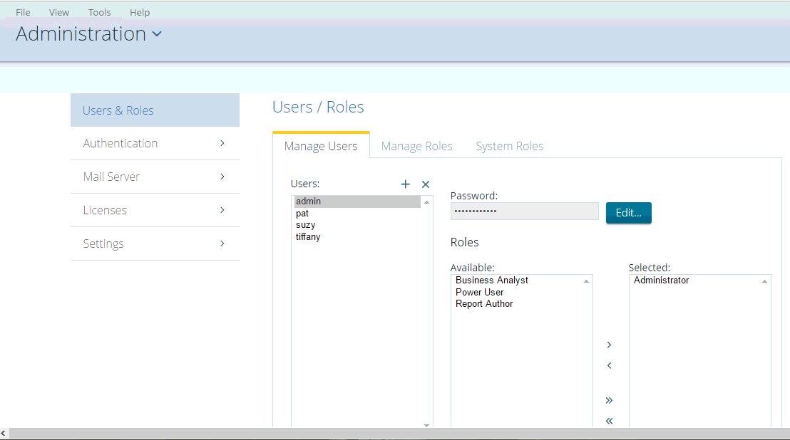
Managing Users and Roles

Slide 131
Managing Users and Roles
Editing User Information
Follow the instructions below to edit user information:
In the Administration Console go to Administration > Users & Roles.
Select the user whose information you want to edit.
In the Details pane, edit the user details as needed.
Deleting Users
Follow the instructions below to delete users and roles from the BI Platform:
In the Administration Console go to
Select the user or users you want to delete from the Users list.
Click the minus sign (-) next to Users to delete the users you selected. A confirm message appears.
Click OK to refresh the user list.

Slide 132
Managing Roles
Adding Roles
Follow the instructions below to add roles to the BI Platform:
In the Administration Console go to Administration > Users & Roles.
Click the Roles icon if you are not in Roles mode.
Click the plus sign (+) next to Roles.
In the new window, type a new Role Name and Description.
Editing Roles
Follow the instructions below to edit roles:
In the Administration Console go to Administration > Users & Roles.
Select the role you want to edit.
In the right pane, edit the details as needed.
Click Update.

Slide 133
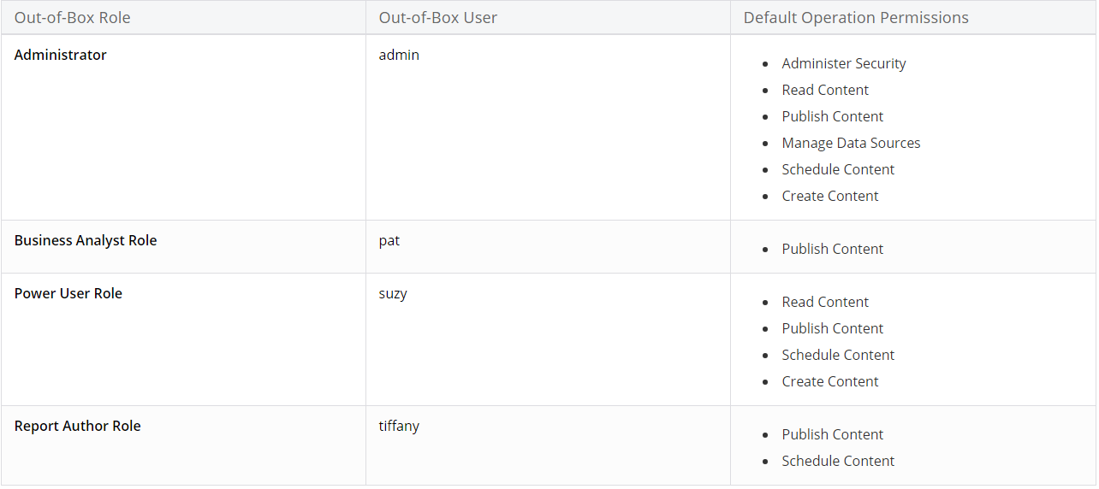
Managing Roles

Slide 134
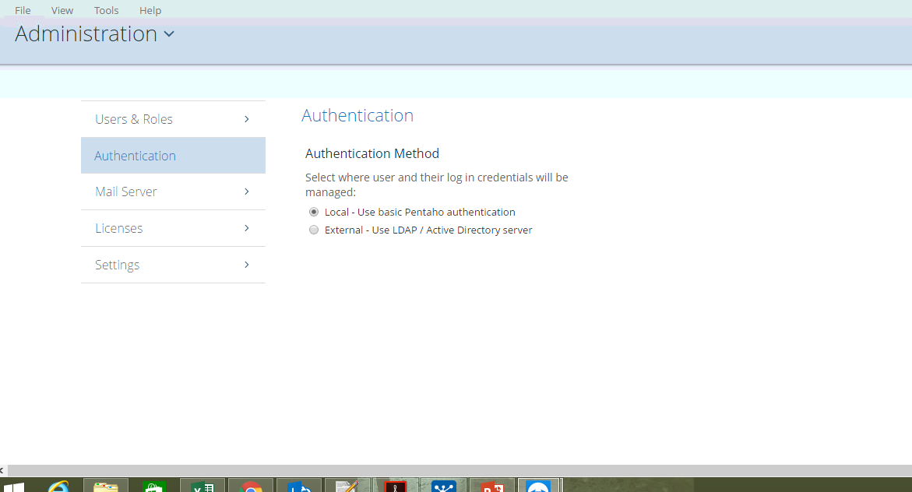
Authentication

Slide 135
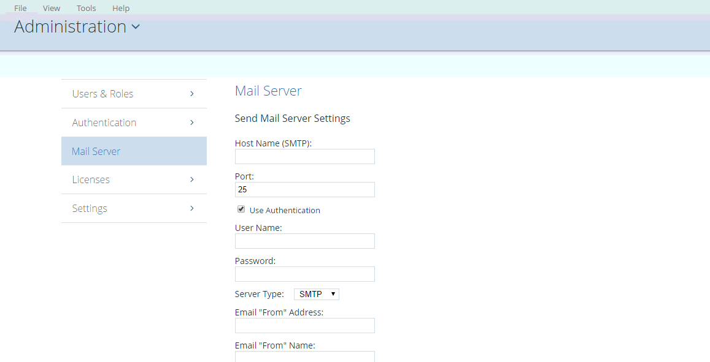
Mail Server

Slide 136
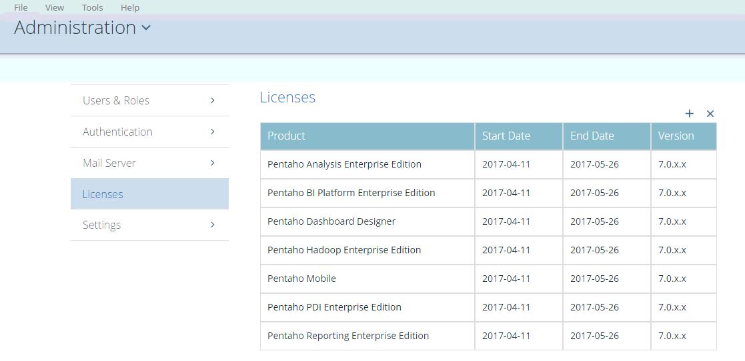
Licenses

Slide 137
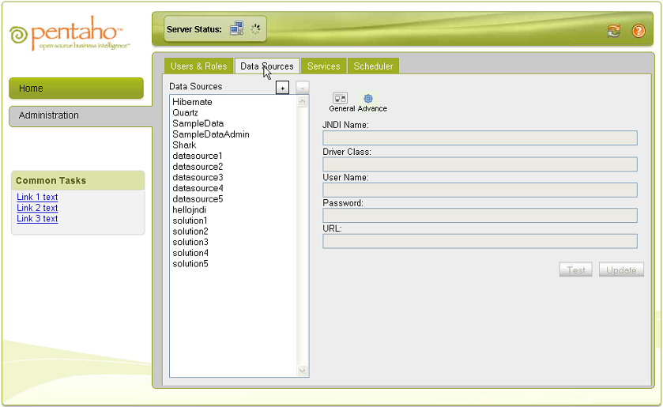
Define Data Sources
The Pre-configured Installation (PCI) includes sample data and reports; however, if you are evaluating Pentaho you will want to use and display your own data in the BI Platform. Defining a data source requires JDBC class name for the database driver, data source URL (server name, port number, database name) and the user ID and password needed to connect the database. Contact your database administrator to get the specific details about your database.

Slide 138
Instructions
In the Administration Console go to Administration > Data Sources.
Click General to display basic configuration options.
Click + (add) if you cannot find your data source in the list.
In the left panel, type an easy-to-remember Connection Name.
Type or select the Driver Class from the list. The database driver name you select depends on the type of database you are accessing. For example, org.hsqldb.jdbcDriver is a sample driver name for a HypersonicSQL database.
Type the User Name and Password required to access your database.
Type or select the URL from the list. This is the URL of your database. For example, jdbc:hsqldb:hsql://localhost/sampledata. JDBC establishes a connection to a SQL-based database and sends and processes SQL statements.
Click Test. A success message appears if the connection is established.
Click OK to save your entries.

Slide 139
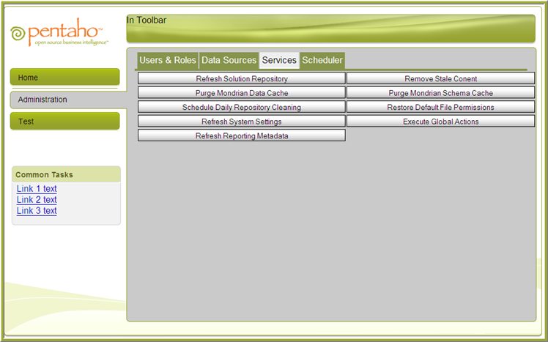
Administration Services

Slide 140
Administration Services
The Scheduler allows you to create, update, delete, run, suspend, and resume one or more schedules, (private and public*), in the BI Platform.
In addition, you can suspend and resume the Scheduler itself. In the context of the BI platform, a schedule is a time (or group of times) associated with an action sequence (or group of action sequences). If you are unfamiliar with action sequences, see Understanding Action Sequences in the Wiki.) In many instances, the output of an action sequence associated with a public schedule is a report;
for example, a sales report to which a manager or salesperson can subscribe. As the administrator, the schedule (or schedules) you designate determines when the Scheduler allows the action sequence to run. Regular schedules are ad hoc, non-subscription schedules, which are associated with one action sequence only.
In addition to associating a time (or group of times in the case of a repeating schedule) with an action sequence (or group of action sequences), the public schedule is also associated with a user's My Workspace. When an action sequence runs on its defined schedule, the output of the action sequence (typically a report) is archived in the My Workspace of the user(s) who have subscribed to that action sequence. This allows the subscribers to view the output of the action sequence (the report) at any time following its execution. (For more information about subscriptions and My Workspace see User Subscriptions).

Slide 141
Entering Schedules
Enter schedules associated with your action sequences in the Schedule Creator dialog box. The Schedule Creator makes it easy for you to enter schedules without having to learn the arcane syntax of Cron expressions; however, it provides you with the option to enter Cron expressions if that is your preference.
Follow the instructions below to use the Schedule Creator:
In the main page of the Pentaho Open Admin Console, click Administration.
Click the Scheduler tab.
In the Scheduler, click first icon on the left to open the Scheduler Creator dialog box.
Under Schedule, enter a Name for the schedule, for example, Monthly Sales.
Enter a Group associated with the schedule, for example, Sales Schedules.
Enter a short Description of the schedule. for example, "Schedule runs on the first of each month, schedule runs on Monday of each week."
Select a Recurrence Type. You can schedule the action sequence to run once at a particular date and time only, or have it recur in seconds, minutes, hours, daily, weekly, monthly, yearly, or recur based on a Cron string. The options in the Recurrence Editor change depending on the type of recurrence you select.

Slide 142

Examining the List of Schedules

Slide 143
Start and Stop BA Server
When you ran the Installation Wizard on Windows, the BA Server is deployed in an Apache Tomcat application server. You can manage the BA Server by clicking Start > All Programs > Pentaho Enterprise Edition > Manage Servers and then select one of these menu items.
Start BA Server
Stop BA Server
The wizard also registered the BA Server, as well as the BA repository, as services. These services are set to run automatically, enabling them to start and stop when the computer running them boots or shuts down. You can use the Windows Services applet found in the Control Panel to start and stop the Pentaho servers and the BA repository.
Click Start > Control Panel > Administrative Tools > Services.
In the Services window, right-click on one of these services in the list and take the appropriate action.
Pentaho BA Server
Pentaho BA Repository

Slide 144
Case Study – Design Pentaho Step Plugin

Slide 145

Create Step Plugins
A transformation step implements a data processing task in an ETL data flow. It operates on a stream of data rows. Transformation steps are designed for input, processing, or output. Input steps fetch data rows from external data sources, such as files or databases. Processing steps work with data rows, perform field calculations, and stream operations, such as joining or filtering. Output steps write the processed data back to storage, files, or databases.
Notes:
Each component is discussed individually below:
Data Source Layer
This represents the different data sources that feed data into the data warehouse. The data source can be of any format -- plain text file, relational database, other types of database, Excel file, etc., can all act as a data source.
Many different types of data can be a data source:
Operations -- such as sales data, HR data, product data, inventory data, marketing data, systems data.
Web server logs with user browsing data.
Internal market research data.
Third-party data, such as census data, demographics data, or survey data.
All these data sources together form the Data Source Layer.
Data Extraction Layer
Data gets pulled from the data source into the data warehouse system. There is likely some minimal data cleansing, but there is unlikely any major data transformation.
Staging Area
This is where data sits prior to being scrubbed and transformed into a data warehouse / data mart. Having one common area makes it easier for subsequent data processing / integration.
ETL Layer
This is where data gains its "intelligence", as logic is applied to transform the data from a transactional nature to an analytical nature. This layer is also where data cleansing happens. The ETL design phase is often the most time-consuming phase in a data warehousing project, and an ETL tool is often used in this layer.
Data Storage Layer
This is where the transformed and cleansed data sit. Based on scope and functionality, 3 types of entities can be found here: data warehouse, data mart, and operational data store (ODS). In any given system, you may have just one of the three, two of the three, or all three types.
Data Logic Layer
This is where business rules are stored. Business rules stored here do not affect the underlying data transformation rules, but do affect what the report looks like.
Data Presentation Layer
This refers to the information that reaches the users. This can be in a form of a tabular / graphical report in a browser, an emailed report that gets automatically generated and sent everyday, or an alert that warns users of exceptions, among others. Usually an OLAP tool and/or a reporting tool is used in this layer.
Metadata Layer
This is where information about the data stored in the data warehouse system is stored. A logical data model would be an example of something that's in the metadata layer. A metadata tool is often used to manage metadata.
System Operations Layer
This layer includes information on how the data warehouse system operates, such as ETL job status, system performance, and user access history.

Slide 146

Create Step Plugins
A step plugin integrates with PDI by implementing four distinct Java interfaces. Each interface represents a set of responsibilities performed by a PDI step. Each of the interfaces has a base class that implements the bulk of the interface in order to simplify plugin development.
Notes:
Each component is discussed individually below:
Data Source Layer
This represents the different data sources that feed data into the data warehouse. The data source can be of any format -- plain text file, relational database, other types of database, Excel file, etc., can all act as a data source.
Many different types of data can be a data source:
Operations -- such as sales data, HR data, product data, inventory data, marketing data, systems data.
Web server logs with user browsing data.
Internal market research data.
Third-party data, such as census data, demographics data, or survey data.
All these data sources together form the Data Source Layer.
Data Extraction Layer
Data gets pulled from the data source into the data warehouse system. There is likely some minimal data cleansing, but there is unlikely any major data transformation.
Staging Area
This is where data sits prior to being scrubbed and transformed into a data warehouse / data mart. Having one common area makes it easier for subsequent data processing / integration.
ETL Layer
This is where data gains its "intelligence", as logic is applied to transform the data from a transactional nature to an analytical nature. This layer is also where data cleansing happens. The ETL design phase is often the most time-consuming phase in a data warehousing project, and an ETL tool is often used in this layer.
Data Storage Layer
This is where the transformed and cleansed data sit. Based on scope and functionality, 3 types of entities can be found here: data warehouse, data mart, and operational data store (ODS). In any given system, you may have just one of the three, two of the three, or all three types.
Data Logic Layer
This is where business rules are stored. Business rules stored here do not affect the underlying data transformation rules, but do affect what the report looks like.
Data Presentation Layer
This refers to the information that reaches the users. This can be in a form of a tabular / graphical report in a browser, an emailed report that gets automatically generated and sent everyday, or an alert that warns users of exceptions, among others. Usually an OLAP tool and/or a reporting tool is used in this layer.
Metadata Layer
This is where information about the data stored in the data warehouse system is stored. A logical data model would be an example of something that's in the metadata layer. A metadata tool is often used to manage metadata.
System Operations Layer
This layer includes information on how the data warehouse system operates, such as ETL job status, system performance, and user access history.

Slide 147
How a Kettle step works
There are 4 classes, that make up the Kettle step. Each has a specific purpose and an important role to play.
TemplateStep: the step class implements the StepInterface. Instances of this class do the actual row processing when the transformation runs. Each thread of execution is represented by an instance of this class. It is given instances of the data and meta classes, when executed.
TemplateStepData: the data class is used for storing data unique to a thread of execution, when the plugin runs. This is where database connections, file handles, caches and other things needed during execution are stored.
TemplateStepMeta: the meta class implements the StepMetaInterface. It is responsible for holding and serializing the settings chosen for a particular instance of the step. For our template step it holds the step name and the name of the output field.
TemplateStepDialog: the dialog class implements the user interface of the step. It shows a dialog allowing the user to configure the step’s behavior to their liking. This dialog class is closely related to the meta class which keeps track of the chosen settings.
Notes:
Each component is discussed individually below:
Data Source Layer
This represents the different data sources that feed data into the data warehouse. The data source can be of any format -- plain text file, relational database, other types of database, Excel file, etc., can all act as a data source.
Many different types of data can be a data source:
Operations -- such as sales data, HR data, product data, inventory data, marketing data, systems data.
Web server logs with user browsing data.
Internal market research data.
Third-party data, such as census data, demographics data, or survey data.
All these data sources together form the Data Source Layer.
Data Extraction Layer
Data gets pulled from the data source into the data warehouse system. There is likely some minimal data cleansing, but there is unlikely any major data transformation.
Staging Area
This is where data sits prior to being scrubbed and transformed into a data warehouse / data mart. Having one common area makes it easier for subsequent data processing / integration.
ETL Layer
This is where data gains its "intelligence", as logic is applied to transform the data from a transactional nature to an analytical nature. This layer is also where data cleansing happens. The ETL design phase is often the most time-consuming phase in a data warehousing project, and an ETL tool is often used in this layer.
Data Storage Layer
This is where the transformed and cleansed data sit. Based on scope and functionality, 3 types of entities can be found here: data warehouse, data mart, and operational data store (ODS). In any given system, you may have just one of the three, two of the three, or all three types.
Data Logic Layer
This is where business rules are stored. Business rules stored here do not affect the underlying data transformation rules, but do affect what the report looks like.
Data Presentation Layer
This refers to the information that reaches the users. This can be in a form of a tabular / graphical report in a browser, an emailed report that gets automatically generated and sent everyday, or an alert that warns users of exceptions, among others. Usually an OLAP tool and/or a reporting tool is used in this layer.
Metadata Layer
This is where information about the data stored in the data warehouse system is stored. A logical data model would be an example of something that's in the metadata layer. A metadata tool is often used to manage metadata.
System Operations Layer
This layer includes information on how the data warehouse system operates, such as ETL job status, system performance, and user access history.

Slide 148

plugin.xml
In addition to the code, there is the plugin.xml file which wires the step into Kettle by specifying its meta class. It also defines the visual appearance of the step and the category it is listed in.
The plugin.xml file is rather simple for most plugins. Its main function is to tell Kettle about the implementation (meta) class, the plugin name and description (localized) as well as additional jar files to load.
Notes:
Each component is discussed individually below:
Data Source Layer
This represents the different data sources that feed data into the data warehouse. The data source can be of any format -- plain text file, relational database, other types of database, Excel file, etc., can all act as a data source.
Many different types of data can be a data source:
Operations -- such as sales data, HR data, product data, inventory data, marketing data, systems data.
Web server logs with user browsing data.
Internal market research data.
Third-party data, such as census data, demographics data, or survey data.
All these data sources together form the Data Source Layer.
Data Extraction Layer
Data gets pulled from the data source into the data warehouse system. There is likely some minimal data cleansing, but there is unlikely any major data transformation.
Staging Area
This is where data sits prior to being scrubbed and transformed into a data warehouse / data mart. Having one common area makes it easier for subsequent data processing / integration.
ETL Layer
This is where data gains its "intelligence", as logic is applied to transform the data from a transactional nature to an analytical nature. This layer is also where data cleansing happens. The ETL design phase is often the most time-consuming phase in a data warehousing project, and an ETL tool is often used in this layer.
Data Storage Layer
This is where the transformed and cleansed data sit. Based on scope and functionality, 3 types of entities can be found here: data warehouse, data mart, and operational data store (ODS). In any given system, you may have just one of the three, two of the three, or all three types.
Data Logic Layer
This is where business rules are stored. Business rules stored here do not affect the underlying data transformation rules, but do affect what the report looks like.
Data Presentation Layer
This refers to the information that reaches the users. This can be in a form of a tabular / graphical report in a browser, an emailed report that gets automatically generated and sent everyday, or an alert that warns users of exceptions, among others. Usually an OLAP tool and/or a reporting tool is used in this layer.
Metadata Layer
This is where information about the data stored in the data warehouse system is stored. A logical data model would be an example of something that's in the metadata layer. A metadata tool is often used to manage metadata.
System Operations Layer
This layer includes information on how the data warehouse system operates, such as ETL job status, system performance, and user access history.

Slide 149

The Meta Class
Please note that the meta class stores the name of the output field of the step in a private member named outputField.
There are more aspects to the meta class. Most of them are covered with a default implementation in BaseStepMeta, which is the parent class of TemplateStepMeta.
Notes:
Each component is discussed individually below:
Data Source Layer
This represents the different data sources that feed data into the data warehouse. The data source can be of any format -- plain text file, relational database, other types of database, Excel file, etc., can all act as a data source.
Many different types of data can be a data source:
Operations -- such as sales data, HR data, product data, inventory data, marketing data, systems data.
Web server logs with user browsing data.
Internal market research data.
Third-party data, such as census data, demographics data, or survey data.
All these data sources together form the Data Source Layer.
Data Extraction Layer
Data gets pulled from the data source into the data warehouse system. There is likely some minimal data cleansing, but there is unlikely any major data transformation.
Staging Area
This is where data sits prior to being scrubbed and transformed into a data warehouse / data mart. Having one common area makes it easier for subsequent data processing / integration.
ETL Layer
This is where data gains its "intelligence", as logic is applied to transform the data from a transactional nature to an analytical nature. This layer is also where data cleansing happens. The ETL design phase is often the most time-consuming phase in a data warehousing project, and an ETL tool is often used in this layer.
Data Storage Layer
This is where the transformed and cleansed data sit. Based on scope and functionality, 3 types of entities can be found here: data warehouse, data mart, and operational data store (ODS). In any given system, you may have just one of the three, two of the three, or all three types.
Data Logic Layer
This is where business rules are stored. Business rules stored here do not affect the underlying data transformation rules, but do affect what the report looks like.
Data Presentation Layer
This refers to the information that reaches the users. This can be in a form of a tabular / graphical report in a browser, an emailed report that gets automatically generated and sent everyday, or an alert that warns users of exceptions, among others. Usually an OLAP tool and/or a reporting tool is used in this layer.
Metadata Layer
This is where information about the data stored in the data warehouse system is stored. A logical data model would be an example of something that's in the metadata layer. A metadata tool is often used to manage metadata.
System Operations Layer
This layer includes information on how the data warehouse system operates, such as ETL job status, system performance, and user access history.

Slide 150
Maintain Step Settings
The implementing class keeps track of step settings using private fields with corresponding get and set methods. The dialog class implementing StepDialogInterface uses these methods to copy the user supplied configuration in and out of the dialog.
These interface methods are also used to maintain settings.
void setDefault()
This method is called every time a new step is created and allocates or sets the step configuration to sensible defaults. The values set here are used by Spoon when a new step is created. This is a good place to ensure that the step settings are initialized to non-null values. Values that are null can be cumbersome to deal with in serialization and dialog population, so most PDI step implementations stick to non-null values for all step settings.
public Object clone()
This method is called when a step is duplicated in Spoon. It returns a deep copy of the step meta object. It is essential that the implementing class creates proper deep copies if the step configuration is stored in modifiable objects, such as lists or custom helper objects.
Notes:
Each component is discussed individually below:
Data Source Layer
This represents the different data sources that feed data into the data warehouse. The data source can be of any format -- plain text file, relational database, other types of database, Excel file, etc., can all act as a data source.
Many different types of data can be a data source:
Operations -- such as sales data, HR data, product data, inventory data, marketing data, systems data.
Web server logs with user browsing data.
Internal market research data.
Third-party data, such as census data, demographics data, or survey data.
All these data sources together form the Data Source Layer.
Data Extraction Layer
Data gets pulled from the data source into the data warehouse system. There is likely some minimal data cleansing, but there is unlikely any major data transformation.
Staging Area
This is where data sits prior to being scrubbed and transformed into a data warehouse / data mart. Having one common area makes it easier for subsequent data processing / integration.
ETL Layer
This is where data gains its "intelligence", as logic is applied to transform the data from a transactional nature to an analytical nature. This layer is also where data cleansing happens. The ETL design phase is often the most time-consuming phase in a data warehousing project, and an ETL tool is often used in this layer.
Data Storage Layer
This is where the transformed and cleansed data sit. Based on scope and functionality, 3 types of entities can be found here: data warehouse, data mart, and operational data store (ODS). In any given system, you may have just one of the three, two of the three, or all three types.
Data Logic Layer
This is where business rules are stored. Business rules stored here do not affect the underlying data transformation rules, but do affect what the report looks like.
Data Presentation Layer
This refers to the information that reaches the users. This can be in a form of a tabular / graphical report in a browser, an emailed report that gets automatically generated and sent everyday, or an alert that warns users of exceptions, among others. Usually an OLAP tool and/or a reporting tool is used in this layer.
Metadata Layer
This is where information about the data stored in the data warehouse system is stored. A logical data model would be an example of something that's in the metadata layer. A metadata tool is often used to manage metadata.
System Operations Layer
This layer includes information on how the data warehouse system operates, such as ETL job status, system performance, and user access history.

Slide 151
Maintain Step Settings
Serialize Step Settings
The plugin serializes its settings to both XML and a PDI repository. These interface methods provide this functionality.
public String getXML()
This method is called by PDI whenever a step serializes its settings to XML. It is called when saving a transformation in Spoon. The method returns an XML string containing the serialized step settings. The string contains a series of XML tags, one tag per setting. The helper class, org.pentaho.di.core.xml.XMLHandler, constructs the XML string.
public void loadXML()
This method is called by PDI whenever a step reads its settings from XML. The XML node containing the step settings is passed in as an argument. Again, the helper class, org.pentaho.di.core.xml.XMLHandler, reads the step settings from the XML node.
Notes:
Each component is discussed individually below:
Data Source Layer
This represents the different data sources that feed data into the data warehouse. The data source can be of any format -- plain text file, relational database, other types of database, Excel file, etc., can all act as a data source.
Many different types of data can be a data source:
Operations -- such as sales data, HR data, product data, inventory data, marketing data, systems data.
Web server logs with user browsing data.
Internal market research data.
Third-party data, such as census data, demographics data, or survey data.
All these data sources together form the Data Source Layer.
Data Extraction Layer
Data gets pulled from the data source into the data warehouse system. There is likely some minimal data cleansing, but there is unlikely any major data transformation.
Staging Area
This is where data sits prior to being scrubbed and transformed into a data warehouse / data mart. Having one common area makes it easier for subsequent data processing / integration.
ETL Layer
This is where data gains its "intelligence", as logic is applied to transform the data from a transactional nature to an analytical nature. This layer is also where data cleansing happens. The ETL design phase is often the most time-consuming phase in a data warehousing project, and an ETL tool is often used in this layer.
Data Storage Layer
This is where the transformed and cleansed data sit. Based on scope and functionality, 3 types of entities can be found here: data warehouse, data mart, and operational data store (ODS). In any given system, you may have just one of the three, two of the three, or all three types.
Data Logic Layer
This is where business rules are stored. Business rules stored here do not affect the underlying data transformation rules, but do affect what the report looks like.
Data Presentation Layer
This refers to the information that reaches the users. This can be in a form of a tabular / graphical report in a browser, an emailed report that gets automatically generated and sent everyday, or an alert that warns users of exceptions, among others. Usually an OLAP tool and/or a reporting tool is used in this layer.
Metadata Layer
This is where information about the data stored in the data warehouse system is stored. A logical data model would be an example of something that's in the metadata layer. A metadata tool is often used to manage metadata.
System Operations Layer
This layer includes information on how the data warehouse system operates, such as ETL job status, system performance, and user access history.

Slide 152
Maintain Step Settings
public void saveRep()
This method is called by PDI whenever a step saves its settings to a PDI repository. The repository object passed in as the first argument provides a set of methods for serializing step settings. The passed in transformation id and step id are used by the step as identifiers when calling the repository serialization methods.
public void readRep()
This method is called by PDI whenever a step reads its configuration from a PDI repository. The step id given in the arguments is used as the identifier when using the repositories serialization methods.
When developing plugins, make sure the serialization code is in synch with the settings available from the step dialog. When testing a step in Spoon, PDI internally saves and loads a copy of the transformation before executing it.
Notes:
Each component is discussed individually below:
Data Source Layer
This represents the different data sources that feed data into the data warehouse. The data source can be of any format -- plain text file, relational database, other types of database, Excel file, etc., can all act as a data source.
Many different types of data can be a data source:
Operations -- such as sales data, HR data, product data, inventory data, marketing data, systems data.
Web server logs with user browsing data.
Internal market research data.
Third-party data, such as census data, demographics data, or survey data.
All these data sources together form the Data Source Layer.
Data Extraction Layer
Data gets pulled from the data source into the data warehouse system. There is likely some minimal data cleansing, but there is unlikely any major data transformation.
Staging Area
This is where data sits prior to being scrubbed and transformed into a data warehouse / data mart. Having one common area makes it easier for subsequent data processing / integration.
ETL Layer
This is where data gains its "intelligence", as logic is applied to transform the data from a transactional nature to an analytical nature. This layer is also where data cleansing happens. The ETL design phase is often the most time-consuming phase in a data warehousing project, and an ETL tool is often used in this layer.
Data Storage Layer
This is where the transformed and cleansed data sit. Based on scope and functionality, 3 types of entities can be found here: data warehouse, data mart, and operational data store (ODS). In any given system, you may have just one of the three, two of the three, or all three types.
Data Logic Layer
This is where business rules are stored. Business rules stored here do not affect the underlying data transformation rules, but do affect what the report looks like.
Data Presentation Layer
This refers to the information that reaches the users. This can be in a form of a tabular / graphical report in a browser, an emailed report that gets automatically generated and sent everyday, or an alert that warns users of exceptions, among others. Usually an OLAP tool and/or a reporting tool is used in this layer.
Metadata Layer
This is where information about the data stored in the data warehouse system is stored. A logical data model would be an example of something that's in the metadata layer. A metadata tool is often used to manage metadata.
System Operations Layer
This layer includes information on how the data warehouse system operates, such as ETL job status, system performance, and user access history.

Slide 153
Maintain Step Settings
Provide Instances of Other Plugin Classes
The StepMetaInterface plugin class is the main class, tying in with the rest of PDI architecture. It is responsible for supplying instances of the other plugin classes implementing StepDialogInterface, StepInterface, and StepDataInterface. The following methods cover these responsibilities. Each method implementation constructs a new instance of the corresponding class, forwarding the passed in arguments to the constructor.
public StepDialogInterface getDialog()
public StepInterface getStep()
public StepDataInterface getStepData()
Each of these methods returns a new instance of the plugin class implementing StepDialogInterface, StepInterface, and StepDataInterface.
Notes:
Each component is discussed individually below:
Data Source Layer
This represents the different data sources that feed data into the data warehouse. The data source can be of any format -- plain text file, relational database, other types of database, Excel file, etc., can all act as a data source.
Many different types of data can be a data source:
Operations -- such as sales data, HR data, product data, inventory data, marketing data, systems data.
Web server logs with user browsing data.
Internal market research data.
Third-party data, such as census data, demographics data, or survey data.
All these data sources together form the Data Source Layer.
Data Extraction Layer
Data gets pulled from the data source into the data warehouse system. There is likely some minimal data cleansing, but there is unlikely any major data transformation.
Staging Area
This is where data sits prior to being scrubbed and transformed into a data warehouse / data mart. Having one common area makes it easier for subsequent data processing / integration.
ETL Layer
This is where data gains its "intelligence", as logic is applied to transform the data from a transactional nature to an analytical nature. This layer is also where data cleansing happens. The ETL design phase is often the most time-consuming phase in a data warehousing project, and an ETL tool is often used in this layer.
Data Storage Layer
This is where the transformed and cleansed data sit. Based on scope and functionality, 3 types of entities can be found here: data warehouse, data mart, and operational data store (ODS). In any given system, you may have just one of the three, two of the three, or all three types.
Data Logic Layer
This is where business rules are stored. Business rules stored here do not affect the underlying data transformation rules, but do affect what the report looks like.
Data Presentation Layer
This refers to the information that reaches the users. This can be in a form of a tabular / graphical report in a browser, an emailed report that gets automatically generated and sent everyday, or an alert that warns users of exceptions, among others. Usually an OLAP tool and/or a reporting tool is used in this layer.
Metadata Layer
This is where information about the data stored in the data warehouse system is stored. A logical data model would be an example of something that's in the metadata layer. A metadata tool is often used to manage metadata.
System Operations Layer
This layer includes information on how the data warehouse system operates, such as ETL job status, system performance, and user access history.

Slide 154
Maintain Step Settings
Provide Instances of Other Plugin Classes
The StepMetaInterface plugin class is the main class, tying in with the rest of PDI architecture. It is responsible for supplying instances of the other plugin classes implementing StepDialogInterface, StepInterface, and StepDataInterface. The following methods cover these responsibilities. Each method implementation constructs a new instance of the corresponding class, forwarding the passed in arguments to the constructor.
public StepDialogInterface getDialog()
public StepInterface getStep()
public StepDataInterface getStepData()
Each of these methods returns a new instance of the plugin class implementing StepDialogInterface, StepInterface, and StepDataInterface.
Notes:
Each component is discussed individually below:
Data Source Layer
This represents the different data sources that feed data into the data warehouse. The data source can be of any format -- plain text file, relational database, other types of database, Excel file, etc., can all act as a data source.
Many different types of data can be a data source:
Operations -- such as sales data, HR data, product data, inventory data, marketing data, systems data.
Web server logs with user browsing data.
Internal market research data.
Third-party data, such as census data, demographics data, or survey data.
All these data sources together form the Data Source Layer.
Data Extraction Layer
Data gets pulled from the data source into the data warehouse system. There is likely some minimal data cleansing, but there is unlikely any major data transformation.
Staging Area
This is where data sits prior to being scrubbed and transformed into a data warehouse / data mart. Having one common area makes it easier for subsequent data processing / integration.
ETL Layer
This is where data gains its "intelligence", as logic is applied to transform the data from a transactional nature to an analytical nature. This layer is also where data cleansing happens. The ETL design phase is often the most time-consuming phase in a data warehousing project, and an ETL tool is often used in this layer.
Data Storage Layer
This is where the transformed and cleansed data sit. Based on scope and functionality, 3 types of entities can be found here: data warehouse, data mart, and operational data store (ODS). In any given system, you may have just one of the three, two of the three, or all three types.
Data Logic Layer
This is where business rules are stored. Business rules stored here do not affect the underlying data transformation rules, but do affect what the report looks like.
Data Presentation Layer
This refers to the information that reaches the users. This can be in a form of a tabular / graphical report in a browser, an emailed report that gets automatically generated and sent everyday, or an alert that warns users of exceptions, among others. Usually an OLAP tool and/or a reporting tool is used in this layer.
Metadata Layer
This is where information about the data stored in the data warehouse system is stored. A logical data model would be an example of something that's in the metadata layer. A metadata tool is often used to manage metadata.
System Operations Layer
This layer includes information on how the data warehouse system operates, such as ETL job status, system performance, and user access history.

Slide 155
Maintain Step Settings
Report Step Changes to the Row Stream
PDI needs to know how a step affects the row structure. A step may be adding or removing fields, as well as modifying the metadata of a field. The method implementing this aspect of a step plugin is getFields().
public void getFields()
Given a description of the input rows, the plugin modifies it to match the structure for its output fields. The implementation modifies the passed in RowMetaInterface object to reflect changes to the row stream. A step adds fields to the row structure. This is done by creating ValueMeta objects, such as the PDI default implementation of ValueMetaInterface, and appending them to the RowMetaInterface object. The Working with Fields section goes into deeper detail about ValueMetaInterface.
This sample transformation uses two steps. The Demo step adds the field, demo_field, to empty rows produced by the Generate Rows step.
Notes:
Each component is discussed individually below:
Data Source Layer
This represents the different data sources that feed data into the data warehouse. The data source can be of any format -- plain text file, relational database, other types of database, Excel file, etc., can all act as a data source.
Many different types of data can be a data source:
Operations -- such as sales data, HR data, product data, inventory data, marketing data, systems data.
Web server logs with user browsing data.
Internal market research data.
Third-party data, such as census data, demographics data, or survey data.
All these data sources together form the Data Source Layer.
Data Extraction Layer
Data gets pulled from the data source into the data warehouse system. There is likely some minimal data cleansing, but there is unlikely any major data transformation.
Staging Area
This is where data sits prior to being scrubbed and transformed into a data warehouse / data mart. Having one common area makes it easier for subsequent data processing / integration.
ETL Layer
This is where data gains its "intelligence", as logic is applied to transform the data from a transactional nature to an analytical nature. This layer is also where data cleansing happens. The ETL design phase is often the most time-consuming phase in a data warehousing project, and an ETL tool is often used in this layer.
Data Storage Layer
This is where the transformed and cleansed data sit. Based on scope and functionality, 3 types of entities can be found here: data warehouse, data mart, and operational data store (ODS). In any given system, you may have just one of the three, two of the three, or all three types.
Data Logic Layer
This is where business rules are stored. Business rules stored here do not affect the underlying data transformation rules, but do affect what the report looks like.
Data Presentation Layer
This refers to the information that reaches the users. This can be in a form of a tabular / graphical report in a browser, an emailed report that gets automatically generated and sent everyday, or an alert that warns users of exceptions, among others. Usually an OLAP tool and/or a reporting tool is used in this layer.
Metadata Layer
This is where information about the data stored in the data warehouse system is stored. A logical data model would be an example of something that's in the metadata layer. A metadata tool is often used to manage metadata.
System Operations Layer
This layer includes information on how the data warehouse system operates, such as ETL job status, system performance, and user access history.

Slide 156
Maintain Step Settings
Validate Step Settings
Spoon supports a Validate Transformation feature, which triggers a self-check of all steps. PDI invokes the check() method of each step on the canvas, allowing each step to validate its settings.
public void check()
Each step has the opportunity to validate its settings and verify that the configuration given by the user is reasonable. In addition, a step checks if it is connected to preceding or following steps, if the nature of the step requires that kind of connection. An input step may expect to not have a preceding step for example. The check method passes in a list of check remarks, to which the method appends its validation results. Spoon displays the list of remarks collected from the steps, allowing you to take corrective action in case there are validation warnings or errors.
Notes:
Each component is discussed individually below:
Data Source Layer
This represents the different data sources that feed data into the data warehouse. The data source can be of any format -- plain text file, relational database, other types of database, Excel file, etc., can all act as a data source.
Many different types of data can be a data source:
Operations -- such as sales data, HR data, product data, inventory data, marketing data, systems data.
Web server logs with user browsing data.
Internal market research data.
Third-party data, such as census data, demographics data, or survey data.
All these data sources together form the Data Source Layer.
Data Extraction Layer
Data gets pulled from the data source into the data warehouse system. There is likely some minimal data cleansing, but there is unlikely any major data transformation.
Staging Area
This is where data sits prior to being scrubbed and transformed into a data warehouse / data mart. Having one common area makes it easier for subsequent data processing / integration.
ETL Layer
This is where data gains its "intelligence", as logic is applied to transform the data from a transactional nature to an analytical nature. This layer is also where data cleansing happens. The ETL design phase is often the most time-consuming phase in a data warehousing project, and an ETL tool is often used in this layer.
Data Storage Layer
This is where the transformed and cleansed data sit. Based on scope and functionality, 3 types of entities can be found here: data warehouse, data mart, and operational data store (ODS). In any given system, you may have just one of the three, two of the three, or all three types.
Data Logic Layer
This is where business rules are stored. Business rules stored here do not affect the underlying data transformation rules, but do affect what the report looks like.
Data Presentation Layer
This refers to the information that reaches the users. This can be in a form of a tabular / graphical report in a browser, an emailed report that gets automatically generated and sent everyday, or an alert that warns users of exceptions, among others. Usually an OLAP tool and/or a reporting tool is used in this layer.
Metadata Layer
This is where information about the data stored in the data warehouse system is stored. A logical data model would be an example of something that's in the metadata layer. A metadata tool is often used to manage metadata.
System Operations Layer
This layer includes information on how the data warehouse system operates, such as ETL job status, system performance, and user access history.

Slide 157
Implement the Step Settings Dialog Box
Java Interface org.pentaho.di.trans.step.StepDialogInterface
Base class org.pentaho.di.ui.trans.step.BaseStepDialog
Maintain the Dialog for Step Settings
The dialog class is responsible for constructing and opening the settings dialog for the step. Whenever you open the step settings in Spoon, the system instantiates the dialog class passing in the StepMetaInterface object and calling open() on the dialog. SWT is the native windowing environment of Spoon and is the framework used for implementing step dialogs.
Notes:
Each component is discussed individually below:
Data Source Layer
This represents the different data sources that feed data into the data warehouse. The data source can be of any format -- plain text file, relational database, other types of database, Excel file, etc., can all act as a data source.
Many different types of data can be a data source:
Operations -- such as sales data, HR data, product data, inventory data, marketing data, systems data.
Web server logs with user browsing data.
Internal market research data.
Third-party data, such as census data, demographics data, or survey data.
All these data sources together form the Data Source Layer.
Data Extraction Layer
Data gets pulled from the data source into the data warehouse system. There is likely some minimal data cleansing, but there is unlikely any major data transformation.
Staging Area
This is where data sits prior to being scrubbed and transformed into a data warehouse / data mart. Having one common area makes it easier for subsequent data processing / integration.
ETL Layer
This is where data gains its "intelligence", as logic is applied to transform the data from a transactional nature to an analytical nature. This layer is also where data cleansing happens. The ETL design phase is often the most time-consuming phase in a data warehousing project, and an ETL tool is often used in this layer.
Data Storage Layer
This is where the transformed and cleansed data sit. Based on scope and functionality, 3 types of entities can be found here: data warehouse, data mart, and operational data store (ODS). In any given system, you may have just one of the three, two of the three, or all three types.
Data Logic Layer
This is where business rules are stored. Business rules stored here do not affect the underlying data transformation rules, but do affect what the report looks like.
Data Presentation Layer
This refers to the information that reaches the users. This can be in a form of a tabular / graphical report in a browser, an emailed report that gets automatically generated and sent everyday, or an alert that warns users of exceptions, among others. Usually an OLAP tool and/or a reporting tool is used in this layer.
Metadata Layer
This is where information about the data stored in the data warehouse system is stored. A logical data model would be an example of something that's in the metadata layer. A metadata tool is often used to manage metadata.
System Operations Layer
This layer includes information on how the data warehouse system operates, such as ETL job status, system performance, and user access history.

Slide 158
Implement the Step Settings Dialog Box
public String open()
This method returns only after the dialog has been confirmed or cancelled. The method must conform to these rules.
If the dialog is confirmed
The StepMetaInterface object must be updated to reflect the new step settings
If you changed any step settings, the Changed flag of the StepMetaInterface object flag must be set to true
open() returns the name of the step
If the dialog is cancelled
The StepMetaInterface object must not be changed
The Changed flag of the StepMetaInterface object must be set to the value it had at the time the dialog opened
open() must return null
The StepMetaInterface object has an internal Changed flag that is accessible using hasChanged() and setChanged(). Spoon decides whether the transformation has unsaved changes based on the Changed flag, so it is important for the dialog to set the flag appropriately.
Notes:
Each component is discussed individually below:
Data Source Layer
This represents the different data sources that feed data into the data warehouse. The data source can be of any format -- plain text file, relational database, other types of database, Excel file, etc., can all act as a data source.
Many different types of data can be a data source:
Operations -- such as sales data, HR data, product data, inventory data, marketing data, systems data.
Web server logs with user browsing data.
Internal market research data.
Third-party data, such as census data, demographics data, or survey data.
All these data sources together form the Data Source Layer.
Data Extraction Layer
Data gets pulled from the data source into the data warehouse system. There is likely some minimal data cleansing, but there is unlikely any major data transformation.
Staging Area
This is where data sits prior to being scrubbed and transformed into a data warehouse / data mart. Having one common area makes it easier for subsequent data processing / integration.
ETL Layer
This is where data gains its "intelligence", as logic is applied to transform the data from a transactional nature to an analytical nature. This layer is also where data cleansing happens. The ETL design phase is often the most time-consuming phase in a data warehousing project, and an ETL tool is often used in this layer.
Data Storage Layer
This is where the transformed and cleansed data sit. Based on scope and functionality, 3 types of entities can be found here: data warehouse, data mart, and operational data store (ODS). In any given system, you may have just one of the three, two of the three, or all three types.
Data Logic Layer
This is where business rules are stored. Business rules stored here do not affect the underlying data transformation rules, but do affect what the report looks like.
Data Presentation Layer
This refers to the information that reaches the users. This can be in a form of a tabular / graphical report in a browser, an emailed report that gets automatically generated and sent everyday, or an alert that warns users of exceptions, among others. Usually an OLAP tool and/or a reporting tool is used in this layer.
Metadata Layer
This is where information about the data stored in the data warehouse system is stored. A logical data model would be an example of something that's in the metadata layer. A metadata tool is often used to manage metadata.
System Operations Layer
This layer includes information on how the data warehouse system operates, such as ETL job status, system performance, and user access history.

Slide 159
Process Rows
Java Interface org.pentaho.di.trans.step.StepInterface
Base class org.pentaho.di.trans.step.BaseStep
The class implementing StepInterface is responsible for the actual row processing when the transformation runs.
The implementing class can rely on the base class and has only three important methods it implements itself. The three methods implement the step life cycle during transformation execution: initialization, row processing, and clean-up.
During initialization PDI calls the init() method of the step once. After all steps have initialized, PDI calls processRow() repeatedly until the step signals that it is done processing all rows. After the step is finished processing rows, PDI calls dispose().
The method signatures have a StepMetaInterface object and a StepDataInterface object. Both objects can be safely cast down to the specific implementation classes of the step.
Notes:
Each component is discussed individually below:
Data Source Layer
This represents the different data sources that feed data into the data warehouse. The data source can be of any format -- plain text file, relational database, other types of database, Excel file, etc., can all act as a data source.
Many different types of data can be a data source:
Operations -- such as sales data, HR data, product data, inventory data, marketing data, systems data.
Web server logs with user browsing data.
Internal market research data.
Third-party data, such as census data, demographics data, or survey data.
All these data sources together form the Data Source Layer.
Data Extraction Layer
Data gets pulled from the data source into the data warehouse system. There is likely some minimal data cleansing, but there is unlikely any major data transformation.
Staging Area
This is where data sits prior to being scrubbed and transformed into a data warehouse / data mart. Having one common area makes it easier for subsequent data processing / integration.
ETL Layer
This is where data gains its "intelligence", as logic is applied to transform the data from a transactional nature to an analytical nature. This layer is also where data cleansing happens. The ETL design phase is often the most time-consuming phase in a data warehousing project, and an ETL tool is often used in this layer.
Data Storage Layer
This is where the transformed and cleansed data sit. Based on scope and functionality, 3 types of entities can be found here: data warehouse, data mart, and operational data store (ODS). In any given system, you may have just one of the three, two of the three, or all three types.
Data Logic Layer
This is where business rules are stored. Business rules stored here do not affect the underlying data transformation rules, but do affect what the report looks like.
Data Presentation Layer
This refers to the information that reaches the users. This can be in a form of a tabular / graphical report in a browser, an emailed report that gets automatically generated and sent everyday, or an alert that warns users of exceptions, among others. Usually an OLAP tool and/or a reporting tool is used in this layer.
Metadata Layer
This is where information about the data stored in the data warehouse system is stored. A logical data model would be an example of something that's in the metadata layer. A metadata tool is often used to manage metadata.
System Operations Layer
This layer includes information on how the data warehouse system operates, such as ETL job status, system performance, and user access history.

Slide 160
Process Rows
Java Interface org.pentaho.di.trans.step.StepInterface
Base class org.pentaho.di.trans.step.BaseStep
The class implementing StepInterface is responsible for the actual row processing when the transformation runs.
The implementing class can rely on the base class and has only three important methods it implements itself. The three methods implement the step life cycle during transformation execution: initialization, row processing, and clean-up.
During initialization PDI calls the init() method of the step once. After all steps have initialized, PDI calls processRow() repeatedly until the step signals that it is done processing all rows. After the step is finished processing rows, PDI calls dispose().
The method signatures have a StepMetaInterface object and a StepDataInterface object. Both objects can be safely cast down to the specific implementation classes of the step.
Notes:
Each component is discussed individually below:
Data Source Layer
This represents the different data sources that feed data into the data warehouse. The data source can be of any format -- plain text file, relational database, other types of database, Excel file, etc., can all act as a data source.
Many different types of data can be a data source:
Operations -- such as sales data, HR data, product data, inventory data, marketing data, systems data.
Web server logs with user browsing data.
Internal market research data.
Third-party data, such as census data, demographics data, or survey data.
All these data sources together form the Data Source Layer.
Data Extraction Layer
Data gets pulled from the data source into the data warehouse system. There is likely some minimal data cleansing, but there is unlikely any major data transformation.
Staging Area
This is where data sits prior to being scrubbed and transformed into a data warehouse / data mart. Having one common area makes it easier for subsequent data processing / integration.
ETL Layer
This is where data gains its "intelligence", as logic is applied to transform the data from a transactional nature to an analytical nature. This layer is also where data cleansing happens. The ETL design phase is often the most time-consuming phase in a data warehousing project, and an ETL tool is often used in this layer.
Data Storage Layer
This is where the transformed and cleansed data sit. Based on scope and functionality, 3 types of entities can be found here: data warehouse, data mart, and operational data store (ODS). In any given system, you may have just one of the three, two of the three, or all three types.
Data Logic Layer
This is where business rules are stored. Business rules stored here do not affect the underlying data transformation rules, but do affect what the report looks like.
Data Presentation Layer
This refers to the information that reaches the users. This can be in a form of a tabular / graphical report in a browser, an emailed report that gets automatically generated and sent everyday, or an alert that warns users of exceptions, among others. Usually an OLAP tool and/or a reporting tool is used in this layer.
Metadata Layer
This is where information about the data stored in the data warehouse system is stored. A logical data model would be an example of something that's in the metadata layer. A metadata tool is often used to manage metadata.
System Operations Layer
This layer includes information on how the data warehouse system operates, such as ETL job status, system performance, and user access history.

Slide 161
Process Rows
Aside from the methods it needs to implement, there is one additional and very important rule: the class must not declare any fields. All variables must be kept as part of the class implementing StepDataInterface.
The reason for this rule is the need to decouple step variables from instances of StepInterface. This enables PDI to implement different threading models to execute a transformation.
Step Initialization
The init() method is called when a transformation is preparing to start execution.
public boolean init()
Every step is given the opportunity to do one-time initialization tasks, such as opening files or establishing database connections. For any steps derived from BaseStep, it is mandatory that super.init() is called to ensure correct behavior. The method returns true in case the step initialized correctly, it returns false if there is an initialization error. PDI will abort the execution of a transformation in case any step returns false upon initialization.
Notes:
Each component is discussed individually below:
Data Source Layer
This represents the different data sources that feed data into the data warehouse. The data source can be of any format -- plain text file, relational database, other types of database, Excel file, etc., can all act as a data source.
Many different types of data can be a data source:
Operations -- such as sales data, HR data, product data, inventory data, marketing data, systems data.
Web server logs with user browsing data.
Internal market research data.
Third-party data, such as census data, demographics data, or survey data.
All these data sources together form the Data Source Layer.
Data Extraction Layer
Data gets pulled from the data source into the data warehouse system. There is likely some minimal data cleansing, but there is unlikely any major data transformation.
Staging Area
This is where data sits prior to being scrubbed and transformed into a data warehouse / data mart. Having one common area makes it easier for subsequent data processing / integration.
ETL Layer
This is where data gains its "intelligence", as logic is applied to transform the data from a transactional nature to an analytical nature. This layer is also where data cleansing happens. The ETL design phase is often the most time-consuming phase in a data warehousing project, and an ETL tool is often used in this layer.
Data Storage Layer
This is where the transformed and cleansed data sit. Based on scope and functionality, 3 types of entities can be found here: data warehouse, data mart, and operational data store (ODS). In any given system, you may have just one of the three, two of the three, or all three types.
Data Logic Layer
This is where business rules are stored. Business rules stored here do not affect the underlying data transformation rules, but do affect what the report looks like.
Data Presentation Layer
This refers to the information that reaches the users. This can be in a form of a tabular / graphical report in a browser, an emailed report that gets automatically generated and sent everyday, or an alert that warns users of exceptions, among others. Usually an OLAP tool and/or a reporting tool is used in this layer.
Metadata Layer
This is where information about the data stored in the data warehouse system is stored. A logical data model would be an example of something that's in the metadata layer. A metadata tool is often used to manage metadata.
System Operations Layer
This layer includes information on how the data warehouse system operates, such as ETL job status, system performance, and user access history.

Slide 162
Process Rows
Once the transformation starts, it enters a tight loop, calling processRow() on each step until the method returns false. In most cases, each step reads a single row from the input stream, alters the row structure and fields, and passes the row on to the next step. Some steps, such as input, grouping, and sorting steps, read rows in batches, or can hold on to the read rows to perform other processing before passing them on to the next step.
public boolean processRow()
A PDI step queries for incoming input rows by calling getRow(), which is a blocking call that returns a row object or null in case there is no more input. If there is an input row, the step does the necessary row processing and calls putRow() to pass the row on to the next step. If there are no more rows, the step calls setOutputDone() and returns false.
The method must conform to these rules.
If the step is done processing all rows, the method calls setOutputDone() and returns false.
If the step is not done processing all rows, the method returns true. PDI calls processRow() again in this case.
Notes:
Each component is discussed individually below:
Data Source Layer
This represents the different data sources that feed data into the data warehouse. The data source can be of any format -- plain text file, relational database, other types of database, Excel file, etc., can all act as a data source.
Many different types of data can be a data source:
Operations -- such as sales data, HR data, product data, inventory data, marketing data, systems data.
Web server logs with user browsing data.
Internal market research data.
Third-party data, such as census data, demographics data, or survey data.
All these data sources together form the Data Source Layer.
Data Extraction Layer
Data gets pulled from the data source into the data warehouse system. There is likely some minimal data cleansing, but there is unlikely any major data transformation.
Staging Area
This is where data sits prior to being scrubbed and transformed into a data warehouse / data mart. Having one common area makes it easier for subsequent data processing / integration.
ETL Layer
This is where data gains its "intelligence", as logic is applied to transform the data from a transactional nature to an analytical nature. This layer is also where data cleansing happens. The ETL design phase is often the most time-consuming phase in a data warehousing project, and an ETL tool is often used in this layer.
Data Storage Layer
This is where the transformed and cleansed data sit. Based on scope and functionality, 3 types of entities can be found here: data warehouse, data mart, and operational data store (ODS). In any given system, you may have just one of the three, two of the three, or all three types.
Data Logic Layer
This is where business rules are stored. Business rules stored here do not affect the underlying data transformation rules, but do affect what the report looks like.
Data Presentation Layer
This refers to the information that reaches the users. This can be in a form of a tabular / graphical report in a browser, an emailed report that gets automatically generated and sent everyday, or an alert that warns users of exceptions, among others. Usually an OLAP tool and/or a reporting tool is used in this layer.
Metadata Layer
This is where information about the data stored in the data warehouse system is stored. A logical data model would be an example of something that's in the metadata layer. A metadata tool is often used to manage metadata.
System Operations Layer
This layer includes information on how the data warehouse system operates, such as ETL job status, system performance, and user access history.

Slide 163
Process Rows
Step Clean-Up
Once the transformation is complete, PDI calls dispose() on all steps.
Public void dispose()
Steps are required to deallocate resources allocated during init() or subsequent row processing. Your implementation should clear all fields of the StepDataInterface object, and ensure that all open files or connections are properly closed. For any steps derived from BaseStep, it is mandatory that super.dispose() is called to ensure correct deallocation.
Notes:
Each component is discussed individually below:
Data Source Layer
This represents the different data sources that feed data into the data warehouse. The data source can be of any format -- plain text file, relational database, other types of database, Excel file, etc., can all act as a data source.
Many different types of data can be a data source:
Operations -- such as sales data, HR data, product data, inventory data, marketing data, systems data.
Web server logs with user browsing data.
Internal market research data.
Third-party data, such as census data, demographics data, or survey data.
All these data sources together form the Data Source Layer.
Data Extraction Layer
Data gets pulled from the data source into the data warehouse system. There is likely some minimal data cleansing, but there is unlikely any major data transformation.
Staging Area
This is where data sits prior to being scrubbed and transformed into a data warehouse / data mart. Having one common area makes it easier for subsequent data processing / integration.
ETL Layer
This is where data gains its "intelligence", as logic is applied to transform the data from a transactional nature to an analytical nature. This layer is also where data cleansing happens. The ETL design phase is often the most time-consuming phase in a data warehousing project, and an ETL tool is often used in this layer.
Data Storage Layer
This is where the transformed and cleansed data sit. Based on scope and functionality, 3 types of entities can be found here: data warehouse, data mart, and operational data store (ODS). In any given system, you may have just one of the three, two of the three, or all three types.
Data Logic Layer
This is where business rules are stored. Business rules stored here do not affect the underlying data transformation rules, but do affect what the report looks like.
Data Presentation Layer
This refers to the information that reaches the users. This can be in a form of a tabular / graphical report in a browser, an emailed report that gets automatically generated and sent everyday, or an alert that warns users of exceptions, among others. Usually an OLAP tool and/or a reporting tool is used in this layer.
Metadata Layer
This is where information about the data stored in the data warehouse system is stored. A logical data model would be an example of something that's in the metadata layer. A metadata tool is often used to manage metadata.
System Operations Layer
This layer includes information on how the data warehouse system operates, such as ETL job status, system performance, and user access history.

Slide 164
Store the Processing State
Java Interface org.pentaho.di.trans.step.StepDataInterface
Base class org.pentaho.di.trans.step.BaseStepData
The class implementing StepInterface does not store processing state in any of its fields. Instead an additional class implementing StepDataInterface is used to store processing state, including status flags, indexes, cache tables, database connections, file handles, and alike. Implementations of StepDataInterface declare the fields used during row processing and add accessor functions. In essence the class implementing StepDataInterface is used as a place for field variables during row processing.
PDI creates instances of the class implementing StepDataInterface at the appropriate time and passes it on to the StepInterface object in the appropriate method calls. The base class already implements all necessary interactions with PDI and there is no need to override any base class methods.
Notes:
Each component is discussed individually below:
Data Source Layer
This represents the different data sources that feed data into the data warehouse. The data source can be of any format -- plain text file, relational database, other types of database, Excel file, etc., can all act as a data source.
Many different types of data can be a data source:
Operations -- such as sales data, HR data, product data, inventory data, marketing data, systems data.
Web server logs with user browsing data.
Internal market research data.
Third-party data, such as census data, demographics data, or survey data.
All these data sources together form the Data Source Layer.
Data Extraction Layer
Data gets pulled from the data source into the data warehouse system. There is likely some minimal data cleansing, but there is unlikely any major data transformation.
Staging Area
This is where data sits prior to being scrubbed and transformed into a data warehouse / data mart. Having one common area makes it easier for subsequent data processing / integration.
ETL Layer
This is where data gains its "intelligence", as logic is applied to transform the data from a transactional nature to an analytical nature. This layer is also where data cleansing happens. The ETL design phase is often the most time-consuming phase in a data warehousing project, and an ETL tool is often used in this layer.
Data Storage Layer
This is where the transformed and cleansed data sit. Based on scope and functionality, 3 types of entities can be found here: data warehouse, data mart, and operational data store (ODS). In any given system, you may have just one of the three, two of the three, or all three types.
Data Logic Layer
This is where business rules are stored. Business rules stored here do not affect the underlying data transformation rules, but do affect what the report looks like.
Data Presentation Layer
This refers to the information that reaches the users. This can be in a form of a tabular / graphical report in a browser, an emailed report that gets automatically generated and sent everyday, or an alert that warns users of exceptions, among others. Usually an OLAP tool and/or a reporting tool is used in this layer.
Metadata Layer
This is where information about the data stored in the data warehouse system is stored. A logical data model would be an example of something that's in the metadata layer. A metadata tool is often used to manage metadata.
System Operations Layer
This layer includes information on how the data warehouse system operates, such as ETL job status, system performance, and user access history.

Slide 165
Store the Processing State
Java Interface org.pentaho.di.trans.step.StepDataInterface
Base class org.pentaho.di.trans.step.BaseStepData
The class implementing StepInterface does not store processing state in any of its fields. Instead an additional class implementing StepDataInterface is used to store processing state, including status flags, indexes, cache tables, database connections, file handles, and alike. Implementations of StepDataInterface declare the fields used during row processing and add accessor functions. In essence the class implementing StepDataInterface is used as a place for field variables during row processing.
PDI creates instances of the class implementing StepDataInterface at the appropriate time and passes it on to the StepInterface object in the appropriate method calls. The base class already implements all necessary interactions with PDI and there is no need to override any base class methods.
Notes:
Each component is discussed individually below:
Data Source Layer
This represents the different data sources that feed data into the data warehouse. The data source can be of any format -- plain text file, relational database, other types of database, Excel file, etc., can all act as a data source.
Many different types of data can be a data source:
Operations -- such as sales data, HR data, product data, inventory data, marketing data, systems data.
Web server logs with user browsing data.
Internal market research data.
Third-party data, such as census data, demographics data, or survey data.
All these data sources together form the Data Source Layer.
Data Extraction Layer
Data gets pulled from the data source into the data warehouse system. There is likely some minimal data cleansing, but there is unlikely any major data transformation.
Staging Area
This is where data sits prior to being scrubbed and transformed into a data warehouse / data mart. Having one common area makes it easier for subsequent data processing / integration.
ETL Layer
This is where data gains its "intelligence", as logic is applied to transform the data from a transactional nature to an analytical nature. This layer is also where data cleansing happens. The ETL design phase is often the most time-consuming phase in a data warehousing project, and an ETL tool is often used in this layer.
Data Storage Layer
This is where the transformed and cleansed data sit. Based on scope and functionality, 3 types of entities can be found here: data warehouse, data mart, and operational data store (ODS). In any given system, you may have just one of the three, two of the three, or all three types.
Data Logic Layer
This is where business rules are stored. Business rules stored here do not affect the underlying data transformation rules, but do affect what the report looks like.
Data Presentation Layer
This refers to the information that reaches the users. This can be in a form of a tabular / graphical report in a browser, an emailed report that gets automatically generated and sent everyday, or an alert that warns users of exceptions, among others. Usually an OLAP tool and/or a reporting tool is used in this layer.
Metadata Layer
This is where information about the data stored in the data warehouse system is stored. A logical data model would be an example of something that's in the metadata layer. A metadata tool is often used to manage metadata.
System Operations Layer
This layer includes information on how the data warehouse system operates, such as ETL job status, system performance, and user access history.

Slide 166
Work with Rows
A row in PDI is represented by a Java object array, Object[]. Each field value is stored at an index in the row. While the array representation is efficient to pass data around, it is not immediately clear how to determine the field names and types that go with the array. The row array itself does not carry this meta data. Also an object array representing a row usually has empty slots towards its end, so a row can accommodate additional fields efficiently.
PDI uses internal objects that implement RowMetaInterface to describe and manipulate row structure. Inside processRow() a step can retrieve the structure of incoming rows by calling getInputRowMeta(), which is provided by the BaseStep class. The step clones the RowMetaInterface object and passes it to getFields() of its meta class to reflect any changes in row structure caused by the step itself. Now, the step has RowMetaInterface objects describing both the input and output rows.
There is a similar object that holds information about individual row fields. PDI uses internal objects that implement ValueMetaInterface to describe and manipulate field information, such as field name, data type, format mask, and alike.
Notes:
Each component is discussed individually below:
Data Source Layer
This represents the different data sources that feed data into the data warehouse. The data source can be of any format -- plain text file, relational database, other types of database, Excel file, etc., can all act as a data source.
Many different types of data can be a data source:
Operations -- such as sales data, HR data, product data, inventory data, marketing data, systems data.
Web server logs with user browsing data.
Internal market research data.
Third-party data, such as census data, demographics data, or survey data.
All these data sources together form the Data Source Layer.
Data Extraction Layer
Data gets pulled from the data source into the data warehouse system. There is likely some minimal data cleansing, but there is unlikely any major data transformation.
Staging Area
This is where data sits prior to being scrubbed and transformed into a data warehouse / data mart. Having one common area makes it easier for subsequent data processing / integration.
ETL Layer
This is where data gains its "intelligence", as logic is applied to transform the data from a transactional nature to an analytical nature. This layer is also where data cleansing happens. The ETL design phase is often the most time-consuming phase in a data warehousing project, and an ETL tool is often used in this layer.
Data Storage Layer
This is where the transformed and cleansed data sit. Based on scope and functionality, 3 types of entities can be found here: data warehouse, data mart, and operational data store (ODS). In any given system, you may have just one of the three, two of the three, or all three types.
Data Logic Layer
This is where business rules are stored. Business rules stored here do not affect the underlying data transformation rules, but do affect what the report looks like.
Data Presentation Layer
This refers to the information that reaches the users. This can be in a form of a tabular / graphical report in a browser, an emailed report that gets automatically generated and sent everyday, or an alert that warns users of exceptions, among others. Usually an OLAP tool and/or a reporting tool is used in this layer.
Metadata Layer
This is where information about the data stored in the data warehouse system is stored. A logical data model would be an example of something that's in the metadata layer. A metadata tool is often used to manage metadata.
System Operations Layer
This layer includes information on how the data warehouse system operates, such as ETL job status, system performance, and user access history.

Slide 167

Work with Rows
A step looks for the indexes and types of relevant fields upon first execution of processRow(). These methods of RowMetaInterface are useful to achieve this.
Notes:
Each component is discussed individually below:
Data Source Layer
This represents the different data sources that feed data into the data warehouse. The data source can be of any format -- plain text file, relational database, other types of database, Excel file, etc., can all act as a data source.
Many different types of data can be a data source:
Operations -- such as sales data, HR data, product data, inventory data, marketing data, systems data.
Web server logs with user browsing data.
Internal market research data.
Third-party data, such as census data, demographics data, or survey data.
All these data sources together form the Data Source Layer.
Data Extraction Layer
Data gets pulled from the data source into the data warehouse system. There is likely some minimal data cleansing, but there is unlikely any major data transformation.
Staging Area
This is where data sits prior to being scrubbed and transformed into a data warehouse / data mart. Having one common area makes it easier for subsequent data processing / integration.
ETL Layer
This is where data gains its "intelligence", as logic is applied to transform the data from a transactional nature to an analytical nature. This layer is also where data cleansing happens. The ETL design phase is often the most time-consuming phase in a data warehousing project, and an ETL tool is often used in this layer.
Data Storage Layer
This is where the transformed and cleansed data sit. Based on scope and functionality, 3 types of entities can be found here: data warehouse, data mart, and operational data store (ODS). In any given system, you may have just one of the three, two of the three, or all three types.
Data Logic Layer
This is where business rules are stored. Business rules stored here do not affect the underlying data transformation rules, but do affect what the report looks like.
Data Presentation Layer
This refers to the information that reaches the users. This can be in a form of a tabular / graphical report in a browser, an emailed report that gets automatically generated and sent everyday, or an alert that warns users of exceptions, among others. Usually an OLAP tool and/or a reporting tool is used in this layer.
Metadata Layer
This is where information about the data stored in the data warehouse system is stored. A logical data model would be an example of something that's in the metadata layer. A metadata tool is often used to manage metadata.
System Operations Layer
This layer includes information on how the data warehouse system operates, such as ETL job status, system performance, and user access history.

Slide 168

Work With Fields
ValueMetaInterface objects are used to determine the characteristics of the row fields. They are typically obtained from a RowMetaInterface object, which is acquired by a call to getInputRowMeta(). The getType() method returns one of the static constants declared by ValueMetaInterface to indicate the PDI field type. Each field type maps to a corresponding native Java type for the actual value. The following table illustrates the mapping of the most frequently used field types.
Notes:
Each component is discussed individually below:
Data Source Layer
This represents the different data sources that feed data into the data warehouse. The data source can be of any format -- plain text file, relational database, other types of database, Excel file, etc., can all act as a data source.
Many different types of data can be a data source:
Operations -- such as sales data, HR data, product data, inventory data, marketing data, systems data.
Web server logs with user browsing data.
Internal market research data.
Third-party data, such as census data, demographics data, or survey data.
All these data sources together form the Data Source Layer.
Data Extraction Layer
Data gets pulled from the data source into the data warehouse system. There is likely some minimal data cleansing, but there is unlikely any major data transformation.
Staging Area
This is where data sits prior to being scrubbed and transformed into a data warehouse / data mart. Having one common area makes it easier for subsequent data processing / integration.
ETL Layer
This is where data gains its "intelligence", as logic is applied to transform the data from a transactional nature to an analytical nature. This layer is also where data cleansing happens. The ETL design phase is often the most time-consuming phase in a data warehousing project, and an ETL tool is often used in this layer.
Data Storage Layer
This is where the transformed and cleansed data sit. Based on scope and functionality, 3 types of entities can be found here: data warehouse, data mart, and operational data store (ODS). In any given system, you may have just one of the three, two of the three, or all three types.
Data Logic Layer
This is where business rules are stored. Business rules stored here do not affect the underlying data transformation rules, but do affect what the report looks like.
Data Presentation Layer
This refers to the information that reaches the users. This can be in a form of a tabular / graphical report in a browser, an emailed report that gets automatically generated and sent everyday, or an alert that warns users of exceptions, among others. Usually an OLAP tool and/or a reporting tool is used in this layer.
Metadata Layer
This is where information about the data stored in the data warehouse system is stored. A logical data model would be an example of something that's in the metadata layer. A metadata tool is often used to manage metadata.
System Operations Layer
This layer includes information on how the data warehouse system operates, such as ETL job status, system performance, and user access history.

Slide 169

Work With Fields
In addition to the data type of a field, the storage type, getStorageType()/setStorageType(), is used to interpret the actual field value in a row array. These storage types are available.
Notes:
Each component is discussed individually below:
Data Source Layer
This represents the different data sources that feed data into the data warehouse. The data source can be of any format -- plain text file, relational database, other types of database, Excel file, etc., can all act as a data source.
Many different types of data can be a data source:
Operations -- such as sales data, HR data, product data, inventory data, marketing data, systems data.
Web server logs with user browsing data.
Internal market research data.
Third-party data, such as census data, demographics data, or survey data.
All these data sources together form the Data Source Layer.
Data Extraction Layer
Data gets pulled from the data source into the data warehouse system. There is likely some minimal data cleansing, but there is unlikely any major data transformation.
Staging Area
This is where data sits prior to being scrubbed and transformed into a data warehouse / data mart. Having one common area makes it easier for subsequent data processing / integration.
ETL Layer
This is where data gains its "intelligence", as logic is applied to transform the data from a transactional nature to an analytical nature. This layer is also where data cleansing happens. The ETL design phase is often the most time-consuming phase in a data warehousing project, and an ETL tool is often used in this layer.
Data Storage Layer
This is where the transformed and cleansed data sit. Based on scope and functionality, 3 types of entities can be found here: data warehouse, data mart, and operational data store (ODS). In any given system, you may have just one of the three, two of the three, or all three types.
Data Logic Layer
This is where business rules are stored. Business rules stored here do not affect the underlying data transformation rules, but do affect what the report looks like.
Data Presentation Layer
This refers to the information that reaches the users. This can be in a form of a tabular / graphical report in a browser, an emailed report that gets automatically generated and sent everyday, or an alert that warns users of exceptions, among others. Usually an OLAP tool and/or a reporting tool is used in this layer.
Metadata Layer
This is where information about the data stored in the data warehouse system is stored. A logical data model would be an example of something that's in the metadata layer. A metadata tool is often used to manage metadata.
System Operations Layer
This layer includes information on how the data warehouse system operates, such as ETL job status, system performance, and user access history.

Slide 170
Work With Fields
In a typical data processing scenario, a step is not interested in dealing with the complexities of the storage type. It just needs the actual data value on which to do processing. In order to safely read the value of a field, the ValueMetaInterface object provides a set of accessor methods to get at the actual Java value. The argument is a value from a row array that corresponds to the ValueMetaInterface object. The accessor methods always return a proper data value, regardless of the field storage type.
getString()
getInteger()
getNumber()
getBigNumber()
getDate()
getBoolean()
getBinary()
For each of these methods, RowMetaInterface has corresponding methods that require the row array and the index of the field as arguments.
Notes:
Each component is discussed individually below:
Data Source Layer
This represents the different data sources that feed data into the data warehouse. The data source can be of any format -- plain text file, relational database, other types of database, Excel file, etc., can all act as a data source.
Many different types of data can be a data source:
Operations -- such as sales data, HR data, product data, inventory data, marketing data, systems data.
Web server logs with user browsing data.
Internal market research data.
Third-party data, such as census data, demographics data, or survey data.
All these data sources together form the Data Source Layer.
Data Extraction Layer
Data gets pulled from the data source into the data warehouse system. There is likely some minimal data cleansing, but there is unlikely any major data transformation.
Staging Area
This is where data sits prior to being scrubbed and transformed into a data warehouse / data mart. Having one common area makes it easier for subsequent data processing / integration.
ETL Layer
This is where data gains its "intelligence", as logic is applied to transform the data from a transactional nature to an analytical nature. This layer is also where data cleansing happens. The ETL design phase is often the most time-consuming phase in a data warehousing project, and an ETL tool is often used in this layer.
Data Storage Layer
This is where the transformed and cleansed data sit. Based on scope and functionality, 3 types of entities can be found here: data warehouse, data mart, and operational data store (ODS). In any given system, you may have just one of the three, two of the three, or all three types.
Data Logic Layer
This is where business rules are stored. Business rules stored here do not affect the underlying data transformation rules, but do affect what the report looks like.
Data Presentation Layer
This refers to the information that reaches the users. This can be in a form of a tabular / graphical report in a browser, an emailed report that gets automatically generated and sent everyday, or an alert that warns users of exceptions, among others. Usually an OLAP tool and/or a reporting tool is used in this layer.
Metadata Layer
This is where information about the data stored in the data warehouse system is stored. A logical data model would be an example of something that's in the metadata layer. A metadata tool is often used to manage metadata.
System Operations Layer
This layer includes information on how the data warehouse system operates, such as ETL job status, system performance, and user access history.

Slide 171
Pentaho Report Designer
Pentaho Report Designer (PRD) is a pixel level accurate reporting tool. It is open source containing rich set of features as listed below:
Rich GUI
Allows to create relational and analytics reports from wide range of data sources
It supports sub-reports, graphs and charts
Supports API based reporting
Pentaho Report Engine executes reports designed by PRD
API based reporting, can easily embedded in any Java application

Slide 172


…
Notes:
Each component is discussed individually below:
Data Source Layer
This represents the different data sources that feed data into the data warehouse. The data source can be of any format -- plain text file, relational database, other types of database, Excel file, etc., can all act as a data source.
Many different types of data can be a data source:
Operations -- such as sales data, HR data, product data, inventory data, marketing data, systems data.
Web server logs with user browsing data.
Internal market research data.
Third-party data, such as census data, demographics data, or survey data.
All these data sources together form the Data Source Layer.
Data Extraction Layer
Data gets pulled from the data source into the data warehouse system. There is likely some minimal data cleansing, but there is unlikely any major data transformation.
Staging Area
This is where data sits prior to being scrubbed and transformed into a data warehouse / data mart. Having one common area makes it easier for subsequent data processing / integration.
ETL Layer
This is where data gains its "intelligence", as logic is applied to transform the data from a transactional nature to an analytical nature. This layer is also where data cleansing happens. The ETL design phase is often the most time-consuming phase in a data warehousing project, and an ETL tool is often used in this layer.
Data Storage Layer
This is where the transformed and cleansed data sit. Based on scope and functionality, 3 types of entities can be found here: data warehouse, data mart, and operational data store (ODS). In any given system, you may have just one of the three, two of the three, or all three types.
Data Logic Layer
This is where business rules are stored. Business rules stored here do not affect the underlying data transformation rules, but do affect what the report looks like.
Data Presentation Layer
This refers to the information that reaches the users. This can be in a form of a tabular / graphical report in a browser, an emailed report that gets automatically generated and sent everyday, or an alert that warns users of exceptions, among others. Usually an OLAP tool and/or a reporting tool is used in this layer.
Metadata Layer
This is where information about the data stored in the data warehouse system is stored. A logical data model would be an example of something that's in the metadata layer. A metadata tool is often used to manage metadata.
System Operations Layer
This layer includes information on how the data warehouse system operates, such as ETL job status, system performance, and user access history.

Slide 173
Mondrian (Analysis Services)
ROLAP Server (Relational Online Analytical Processing)
This comes under analysis services and codenamed as Mondiran, which is very useful to slice and dice the data
Open Source OLAP server written on pure java
Supports MDX query language
Mondrian schema is universal metadata descriptor supported by almost any OLAP client tool
Notes:
Each component is discussed individually below:
Data Source Layer
This represents the different data sources that feed data into the data warehouse. The data source can be of any format -- plain text file, relational database, other types of database, Excel file, etc., can all act as a data source.
Many different types of data can be a data source:
Operations -- such as sales data, HR data, product data, inventory data, marketing data, systems data.
Web server logs with user browsing data.
Internal market research data.
Third-party data, such as census data, demographics data, or survey data.
All these data sources together form the Data Source Layer.
Data Extraction Layer
Data gets pulled from the data source into the data warehouse system. There is likely some minimal data cleansing, but there is unlikely any major data transformation.
Staging Area
This is where data sits prior to being scrubbed and transformed into a data warehouse / data mart. Having one common area makes it easier for subsequent data processing / integration.
ETL Layer
This is where data gains its "intelligence", as logic is applied to transform the data from a transactional nature to an analytical nature. This layer is also where data cleansing happens. The ETL design phase is often the most time-consuming phase in a data warehousing project, and an ETL tool is often used in this layer.
Data Storage Layer
This is where the transformed and cleansed data sit. Based on scope and functionality, 3 types of entities can be found here: data warehouse, data mart, and operational data store (ODS). In any given system, you may have just one of the three, two of the three, or all three types.
Data Logic Layer
This is where business rules are stored. Business rules stored here do not affect the underlying data transformation rules, but do affect what the report looks like.
Data Presentation Layer
This refers to the information that reaches the users. This can be in a form of a tabular / graphical report in a browser, an emailed report that gets automatically generated and sent everyday, or an alert that warns users of exceptions, among others. Usually an OLAP tool and/or a reporting tool is used in this layer.
Metadata Layer
This is where information about the data stored in the data warehouse system is stored. A logical data model would be an example of something that's in the metadata layer. A metadata tool is often used to manage metadata.
System Operations Layer
This layer includes information on how the data warehouse system operates, such as ETL job status, system performance, and user access history.

Slide 174

Mondrian Dashboard
Notes:
Each component is discussed individually below:
Data Source Layer
This represents the different data sources that feed data into the data warehouse. The data source can be of any format -- plain text file, relational database, other types of database, Excel file, etc., can all act as a data source.
Many different types of data can be a data source:
Operations -- such as sales data, HR data, product data, inventory data, marketing data, systems data.
Web server logs with user browsing data.
Internal market research data.
Third-party data, such as census data, demographics data, or survey data.
All these data sources together form the Data Source Layer.
Data Extraction Layer
Data gets pulled from the data source into the data warehouse system. There is likely some minimal data cleansing, but there is unlikely any major data transformation.
Staging Area
This is where data sits prior to being scrubbed and transformed into a data warehouse / data mart. Having one common area makes it easier for subsequent data processing / integration.
ETL Layer
This is where data gains its "intelligence", as logic is applied to transform the data from a transactional nature to an analytical nature. This layer is also where data cleansing happens. The ETL design phase is often the most time-consuming phase in a data warehousing project, and an ETL tool is often used in this layer.
Data Storage Layer
This is where the transformed and cleansed data sit. Based on scope and functionality, 3 types of entities can be found here: data warehouse, data mart, and operational data store (ODS). In any given system, you may have just one of the three, two of the three, or all three types.
Data Logic Layer
This is where business rules are stored. Business rules stored here do not affect the underlying data transformation rules, but do affect what the report looks like.
Data Presentation Layer
This refers to the information that reaches the users. This can be in a form of a tabular / graphical report in a browser, an emailed report that gets automatically generated and sent everyday, or an alert that warns users of exceptions, among others. Usually an OLAP tool and/or a reporting tool is used in this layer.
Metadata Layer
This is where information about the data stored in the data warehouse system is stored. A logical data model would be an example of something that's in the metadata layer. A metadata tool is often used to manage metadata.
System Operations Layer
This layer includes information on how the data warehouse system operates, such as ETL job status, system performance, and user access history.

Slide 175

Pentaho in Production
Notes:
Which Dimensions To Include
Determining which dimensions to include is usually a straightforward process, because business processes will often dictate clearly what are the relevant dimensions.
For example, in an off-line retail world, the dimensions for a sales fact table are usually time, geography, and product. This list, however, is by no means a complete list for all off-line retailers. A supermarket with a Rewards Card program, where customers provide some personal information in exchange for a rewards card, and the supermarket would offer lower prices for certain items for customers who present a rewards card at checkout, will also have the ability to track the customer dimension. Whether the data warehousing system includes the customer dimension will then be a decision that needs to be made.
What Level Within Each Dimension To Include
Determining which part of hierarchy the information is stored along each dimension is not an exact science. This is where user requirement (both stated and possibly future) plays a major role.
In the above example, will the supermarket wanting to do analysis along at the hourly level? (i.e., looking at how certain products may sell by different hours of the day.) If so, it makes sense to use 'hour' as the lowest level of granularity in the time dimension. If daily analysis is sufficient, then 'day' can be used as the lowest level of granularity. Since the lower the level of detail, the larger the data amount in the fact table, the granularity exercise is in essence figuring out the sweet spot in the tradeoff between detailed level of analysis and data storage.

